Slide 1
Re-imagining resistance (care conceptualization in a post pandemic world)
Kenneth L. Roberts MPS, LPCC, LADC, DBH Candidate KEN.ROBERTS@NUWAY.ORG
Co-Occurring Symposium
Rochester, MN January 25-27, 2027
Notes:
Hello- welcome to the session. I am honored by the opportunity to present “Re-Imagining Resistance” at the Symposium in 2023. My name is Ken Roberts- I work as the Chief Clinical Officer for the NUWAY Alliance. The Alliance is a MN based non-profit with a mission to provide leadership, innovation and recovery support in the behavioral health space. That mission currently encompasses 14 programs in eight cities and two states. Our clinical programs provide licensed co-occurring residential and outpatient services covering ASAM care levels 3.1. 2.1, 1.0 and we are participants in the MN state 1115 waiver project. Please feel free to contact me at any time utilizing the email on-screen and please be sure to spend some quality time with our enthusiastic Community Relations Team and take home some swag!

Slide 2
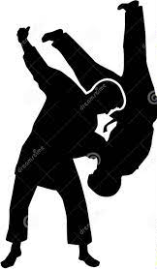
Basic Objectives
Define the Biodyne Model.
Differentiate “Onion v. Garlic” case presentations.
Conceptualize applied interventions utilizing patient/client resistance (“psycho-judo”).
Notes:
Here are our overarching objectives for the session- read slide

Slide 3
Notes:
When we consider the concepts of motivation and resistance, we are talking, of course about Dimension 4- called “Readiness to Change”

Slide 4
Notes:
This version of the ASAM ratings crosswalk offers a useful reminder of how we evaluate client ratings in a co-occurring framework and highlights one of the concepts (TTM) most aligned with our field.

Slide 5
Notes:
Prochaska & DiClemente’s seminal work on the transtheoretical model of change has become synonymous in many ways with SUD

Slide 6
Notes:
In plainer language this simple graphic illustrates the scale in easily recognizable fashion, however, what we all know and see regularly is that in real life, these stages are seldom clearly defined nor static.

Slide 7
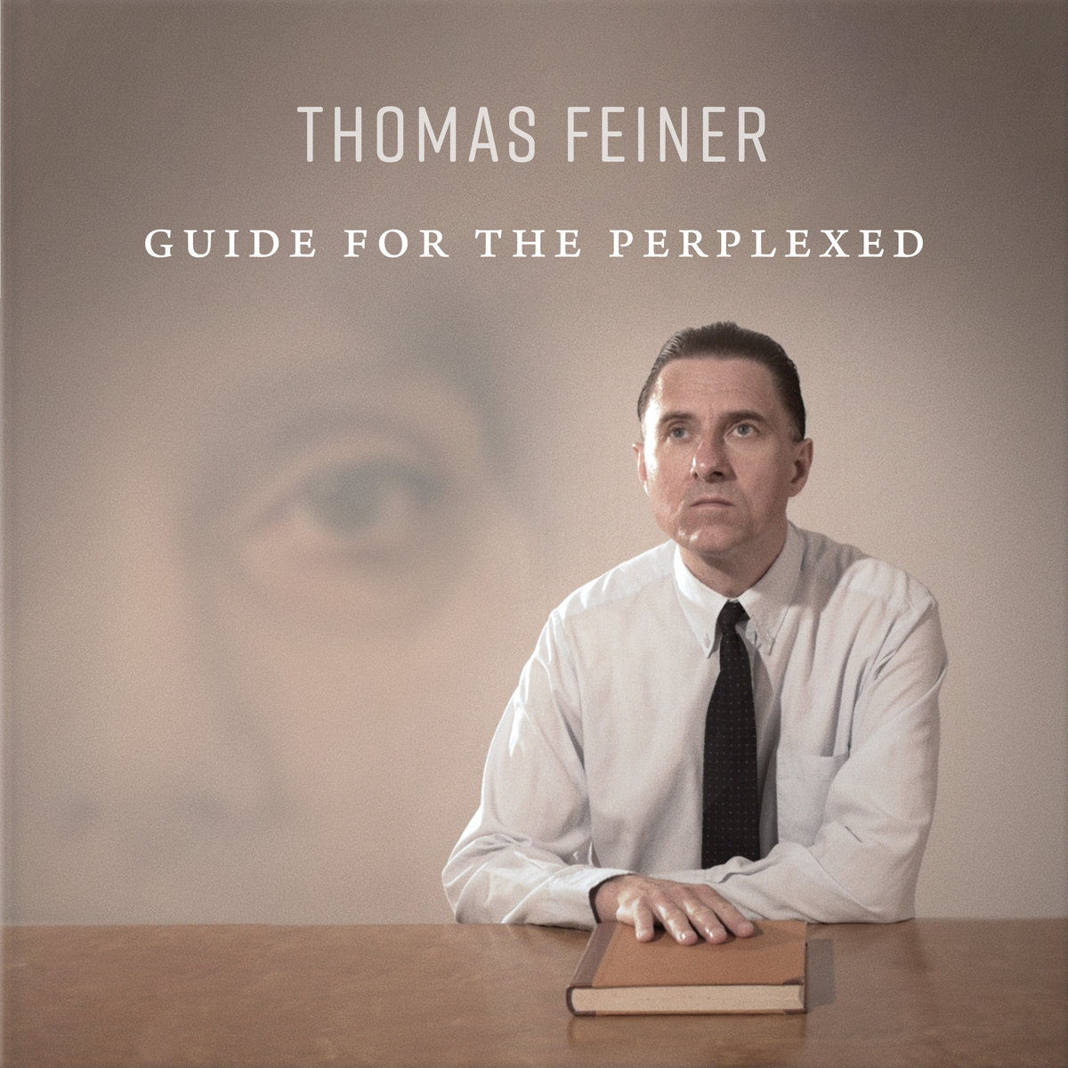
Clinical Conundrums…?
Fluidity (snapshots in time)
Gray areas…
Information deficits
Stereotypes (“must hit bottom…”)
Biases (clinician/client)
External pressures (legal, family etc.)
Societal perceptions (stigma)
Notes:
Which often times makes effectively evaluating this facet of a care a very subjective task. We don’t need to look any further than our own internal world to remember that motivation is a fluid concept that can differ from moment to moment based on myriad factors. This immediately presents some significant gray areas in the consideration of how we evaluate this aspect in others. This may be heightened further in the SUD field where long held tenets may intersect with bias, perception and a range of external pressures.

Slide 8
Notes:
Recognition of the role of stigma must be infused into all of our interventions

Slide 9
OUR WORDS MATTER!
Notes:
A lot of language from “treatment” culture still persists- it is important to recognize the role OUR language plays in perception- for the client, the public and US! READ study finding= BIAS (based on one phrase, those being labeled as “abusers” would be far more likely be perceived and potentially evaluated as “less-motivated”)

Slide 10
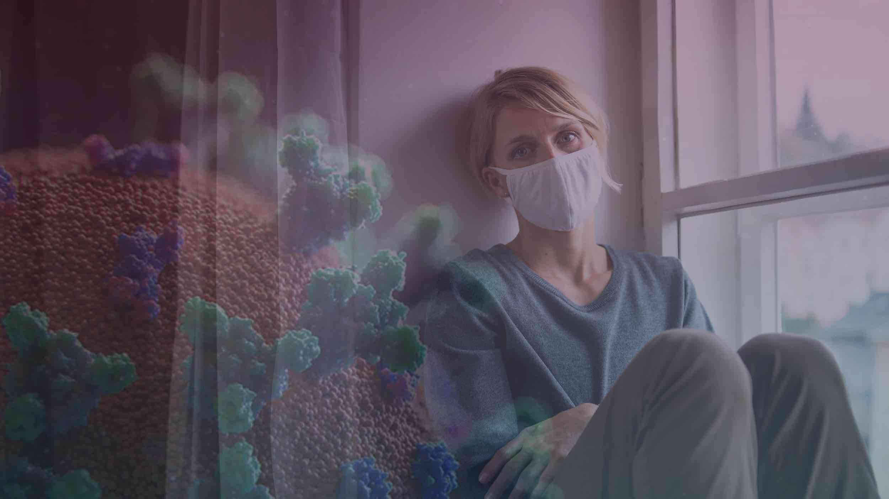
Pandemic Trauma and Stress Experience (PTSE)
American Psychoanalytic Association (APsaA) has outlined the psychological impact of the pandemic on individuals, families, and communities
Caused by having to adapt to a prolonged “pandemic way of life”, filled with uncertainty, fear, and loss — can increase our experiences of depression, anxiety, sadness, loneliness, relational conflicts, substance abuse or misuse, and even violence
Responses can range from subtle to serious and are different for different people
“It is important to understand that PTSE is not a diagnosis or disorder. It is a shared community phenomenon centered on adapting together”
“ALL OF US ARE EXPERIENCING SOME LEVEL OF PTSE” (Todd Essig co-Chair APSA Advisory Taskforce)
https://apsa.org/PTSE
Notes:
Compounding these existing dynamics is the experience we have all endured in the past several years. Some of you may be familiar with this concept. Brief poll- raise hands- “How many people in here in the last year have felt less willing to engage in an activity due anxiety, fear, sadness etc.?” (“Me too!”) Does that make us unmotivated

Slide 11
CORONAVIRUS OUTBREAK
MARCH 2020-?
Anxiety/Depression= 40%+
DRUG OVERDOSE DEATHS= 30%+
Trauma/stressor= 26%+
SUBSTANCE USE (START/INCREASE)= 13%+
SUICIDAL IDEATION= 11%+
“DEATHS OF DESPAIR”
Notes:
These statistics both highlight pandemic impact and the changing profile of the clients presenting for our services. Recent science underscores the impact of trauma further on the concept of motivation- a 2022 study conducting cortisol testing as part SUD treatment intake demonstrated that higher cortisol levels were correlated to shorter length of engagement and successful completion (Maddox-Rooper et al, 2022)

Slide 12
“These are not the same clients we have worked with in the past”
(acuity, behavior, etc.)
Notes:
This quote is from a conversation with my VP of OP services on 8.1.22 and is reflective of narrative I have heard repeatedly across areas of the field. I believe it refers to a range of intersecting factors. Let’s consider some to the underpinnings of this dynamic

Slide 13
Notes:
I’ll reiterate that none of us are exempt from or immune to some of these factors- they are impacting both those we serve and capacity of staff. Most of our focus today is towards care delivery but I want to circle back in our closing to remind us about the value of our own care and the role of leadership in maintaining sustainable environments.

Slide 14
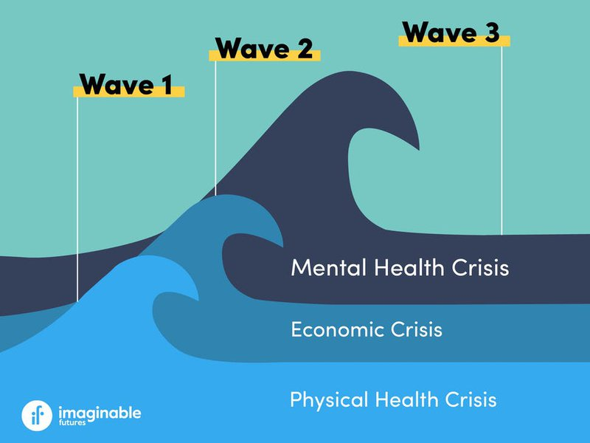
Notes:
Part of the enduring strain of the pandemic has been the uncertainly of its actual end leading to chronic stress and erosion of even our most healthy coping strategies. As we look at different trajectories world wide we can chart the ebbs and flows of societal and personal emotions. The statistics and dynamics we’re reviewing suggest that the “third wave” of behavioral health needs will persist long after pandemic subsides. (reminder about other historical trauma).

Slide 15
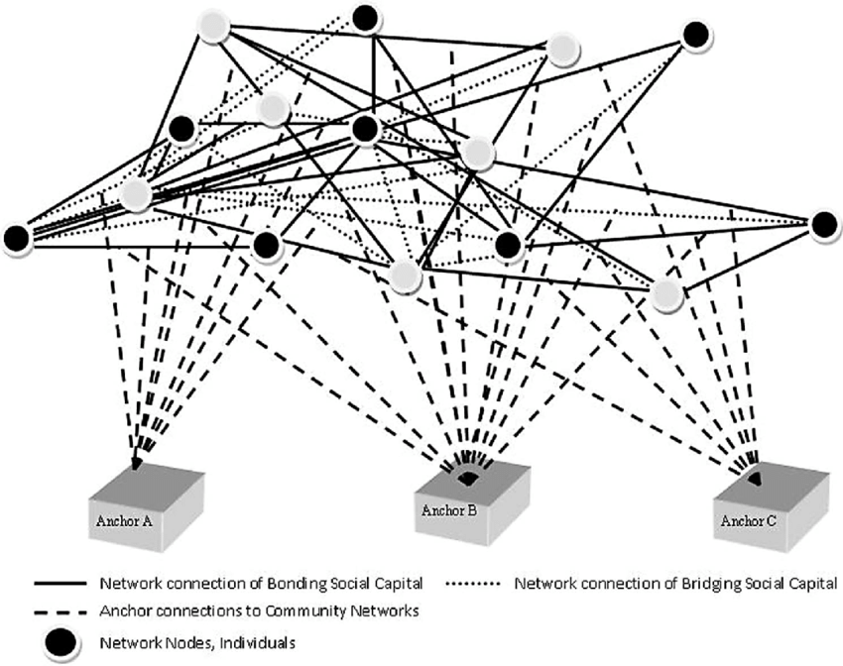
Loss of “Social Anchors” (Accountability)
Isolation (social skill erosion)
Group Living (Res Tx, RR)
Support Groups
Legal/Courts
Societal Priorities
Notes:
Review key points (societal- recent poll that does not place SUD in top ten societal concerns)

Slide 16
System Changes (Access/Accountability)
Telehealth
MN 1115
MN Direct Access
MN Cannabis
MN Tx Statistics
“Deaths of Despair”
Notes:
Highlight system & state specific

Slide 17
SOLUTION FOCUS!
Notes:
Some of the underlying concepts impacting client motivation beyond the scope of our focus today but I encourage us all to keep them in mind along with the daily work we do. Let’s turn our attention to how we can best treat the client profiles and additional layers of resistance we will be seeing

Slide 18
BIODYNE INTRODUCTION
Nicholas A. Cummings, Ph.D., Sc.D. (1924 - 2020)
Former President of APA
Chief of MH for Kaiser Permanente
MH Inclusion
Demonstrated $ savings
American Biodyne
Only psychology based managed care
25 million covered
Silicon Valley-Jobs & Gates (inspiration)
Cummings Institute (2014)
https://cgi.edu/nicholascummings/
Notes:
Biodyne aptly means, “Life change”- developed by NC- Prolific author, “maverick”, interesting history (Ted Bundy anecdote)- system disruptor!

Slide 19
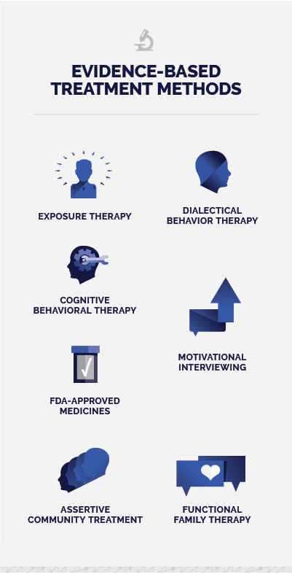
BIODYNE DEVELOPMENT
THE BIODYNE MODEL IS A FRAMEWORK DESIGNED TO INTEGRATE EVIDENCE BASED MODALITIES IN THE SERVICE OF OUTCOMES!
FOUNDATIONAL PRACTICES INCLUDING MOTIVATIONAL INTERVIEWING AND COGNITIVE BEHAVIORAL THERAPY ARE ENCOURAGED, NOT EXCLUDED!
CLINICIANS ARE ENCOURAGED TO THINK “OUTSIDE OF THE BOX” REGARDING CARE STRATEGIES AND SYSTEMS!
Notes:
CGI founded with daughter Janet & wife- Biodyne emphasizes innovation but does NOT eliminate other evidence-based applications. I want to emphasize that none of the concepts or intervention we review preclude utilization of other skill-sets you possess but are offered as complimentary tools that I believe are useful in terms of assessing and addressing motivational aspects in client presentation. When we think of resistance, I think most of us think of MI- those principles fit well with in the Biodyne model. As further example, I myself have developed a primary CBT orientation which I continue to utilize along with skills from ART- Biodyne has offered me new lens to evaluate better application of those modalities and to add some additional tools to the mix.

Slide 20
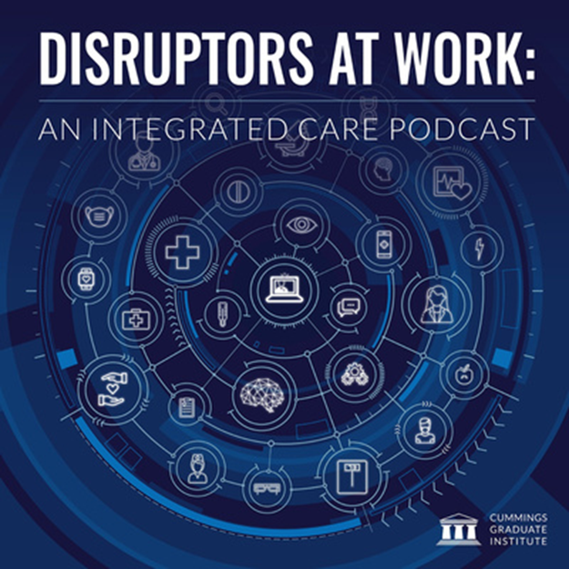
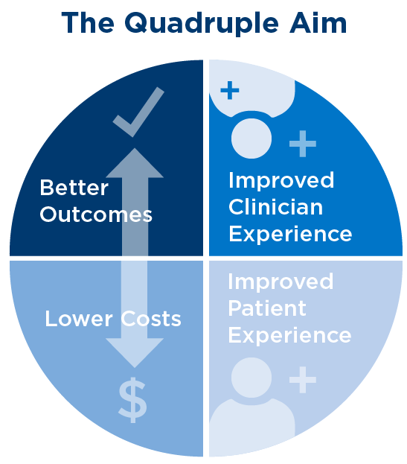
BIODYNE FOCUS
Partnership and Collaboration
People First
Teamwork
Trust
Impact
Innovation
Accountability
Access and Diversity
Notes:
Overview of Biodyne focus on achieving systems change

Slide 21
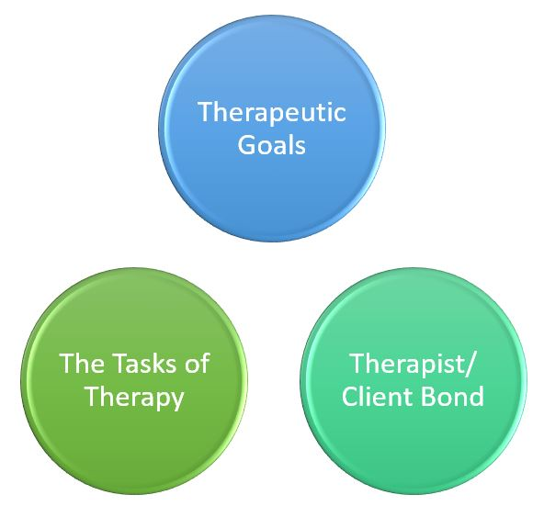
BIODYNE ALLIANCE
As summarized by Harwood, Beutler, Castillo, and Karno (2006), considerable research suggests that common factors in general, and the therapeutic alliance in particular, could possibly be one of the most important elements in treatment outcome, such that neglecting these common factors could negatively impact the efficacy of therapy.
Notes:
Biodyne model underscores importance of alliance as we’ll see in patient bill of rights and therapeutic contract

Slide 22
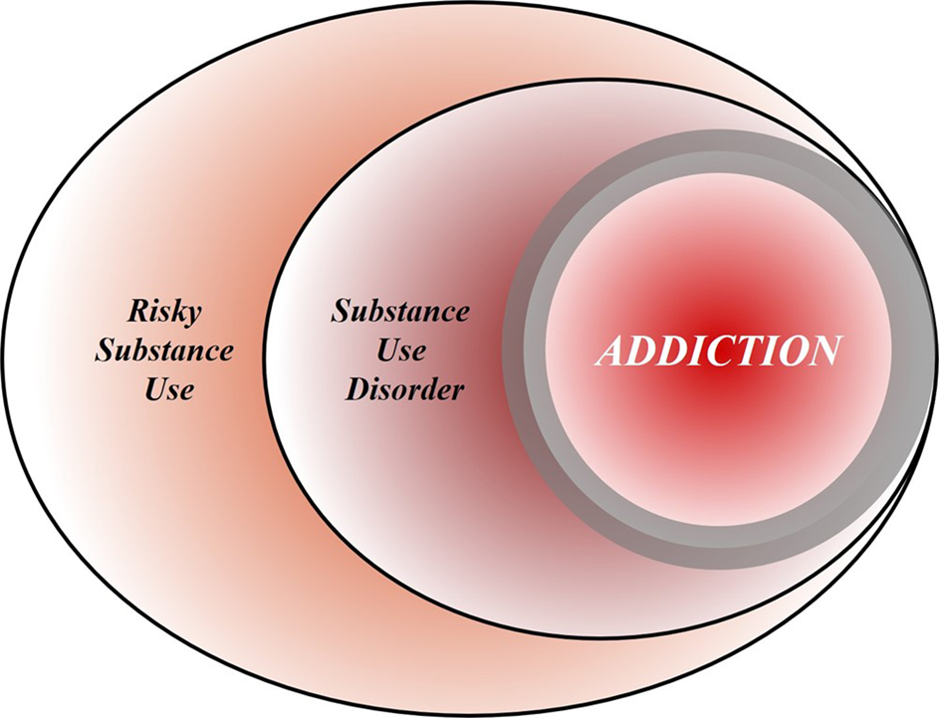
Identifying “Pre-Addiction” (Proactive Integration)
McClellan (Tx Research institute), Koob (NIAA) & Volkow (NIDA)
“Pre-Diabetes” model for SUD
Measures to define and detect pre-addiction. While research efforts into neurological factors and other objective measures of early addiction evolve, DSM-5’s criteria for mild and moderate addiction are a “reasonable starting point” for clinicians to define pre-addiction.
Engaging, effective interventions for pre-addiction. In addition to screening, intervention and referral to treatment for the early stages of substance use, the authors call for a broader range of medications, as well as social support and awareness—including use of social media such as Twitter, TikTok and YouTube.
Public and clinical advocacy. The authors call for more education in medical and nursing schools on procedures for screening and tracking early-stage substance use, and greater willingness from insurers to reimburse such procedures.
Time to Recognize, and Treat, Pre-addiction - Treatment Magazine
Notes:
Although we’re focusing today on applying a Biodyne lens to existing SUD and co-occurring disorders, its focus through CGI has really evolved towards proactive integration on the front end of the care spectrums- particularly primary care settings.. Many of our referrals come from these areas because they don’t know “what to do” with these clients. That conceptualization echoed in recent article by some of the thought leaders in our field- anecdotal of pre-diabetes campaign achieving great results!

Slide 23
Notes:
Read- review

Slide 24
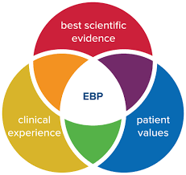
“Providing relief from pain, anxiety, and depression in the shortest time possible and with the least intrusive intervention.”
Effective
Evidence Based
Efficient
Notes:
Foundation of the Therapeutic alliance

Slide 25
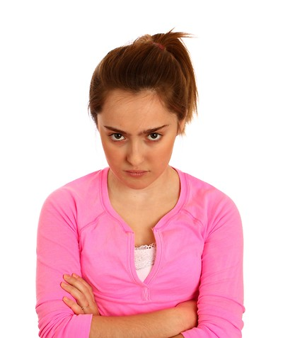
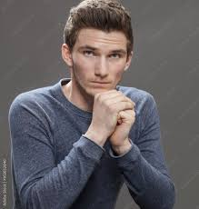
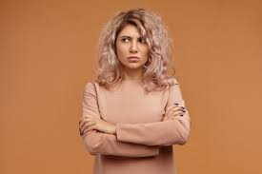
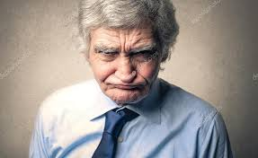
Biodyne Concept of Resistance
By the time patients arrive for treatment, they are typically quite set in their ways, albeit unhealthy ways, of coping with anxiety, stress, depression, etc.
These “ways” may not be working at all but the patient cannot imagine an alternative.
“Repetition compulsion” sets in…the patient fears “falling into the abyss of permanent anxiety and despair” should the therapist try to take away their dysfunctional coping mechanisms.
The patient fights the therapist all the way, even when they agree that a change needs to be made because they feel trapped.
Notes:
The intersection of trauma & SUD means many of our clients have been utilizing the only coping mechanism that provides ANY relief. They go back to it even when it is harmful to seek the modicum of relief still provided. Difficult to force change head on. Have you seen any faces like these in your offices or group rooms…?!?

Slide 26
Biodyne Model’s View of Resistance
Patients have developed ways of coping, healthy or unhealthy, that helps them maintain “homeostasis” – asking a patient to take these coping mechanisms away, before one is ready, will result in increased resistance.
The patient is entitled to their resistance.
The model refocuses the resistance and makes it an ally in the treatment and moves the treatment forward at a more rapid and effective pace.
How? Let’s see…
Notes:
Sounds similar to MI!

Slide 27
Legend
Notes:
Template for Biodyne care: Categorize (will determine care conceptualization), Dx (differenetiate DSM for medical v, Biodyne rationale), Op Dx (why now?), Explicit/Implicit (stated v. true reason). These will determine entry point (where we start) and techniques to employ (including existing). Emphasize HW rationale. Note that due to time we will really be touching on these at a high level- happy to talk further after presentation

Slide 28
Who’s Presenting? The Differential Diagnosis
Notes:
Metaphor of two people who go for lunch…Seldom clear cut- elements of both. Biodyne posits that garlic must always be addressed first in order to reach onion insight

Slide 29
Notes:
Onion= repression, Garlic= Denial; both types of “resistance” Note fluidity of personality disorders

Slide 30
Notes:
OD may be different than what is “coded”, which is necessary for systems & payment- both are needed, This is where the assessment of motivation to begin formulating treatment occurs

Slide 31
Why is it important to know the Operational Diagnosis?
Knowing the real reason, the patient is seeking help, instead of the rationalized reason the patient will most often present, will determine the treatment plan.
Example: Kim (the patient) may state, “I am drinking too much.” But Kim has been drinking alcoholically for many years; this statement does not reveal why now?
Kim may not want to stop drinking. Kim’s pain may actually be rooted in the impending loss of the marriage and Kim may want therapy solely to attempt to salvage the marriage. A treatment plan for Kim that focused solely on abstinence would be met with resistance.
Notes:
Getting to the truth

Slide 32
Questions to ask…
“What brings you in for treatment now?”
CAUTION: What seems obvious is most often the wrong conclusion!
“What were you thinking the precise moment you picked up the phone and called for an appointment?”
Many patients have thought about making an appointment many times before but they never called.
Attempt to uncover what was pushing them to go through with it this time.
In the example from the last slide…Kim has been drinking for many years and during that time, Riley (Kim’s spouse) frequently threatened to kick Kim out but Riley did not follow through with the threat until the week before Kim came to your office.
Knowing this gets you closer to the operational diagnosis.
Notes:
Getting to the truth

Slide 33
Explicit Contract
The reason the patient provides as to why they are currently seeking treatment.
The explicit contract is the patient’s rationalized or face-saving reason for coming in (what they can tolerate now)
If this is the only contract utilized, it will lead the therapy into meaningless, ineffective directions.
If the difference between the explicit and implicit contract is too great, therapy will be sabotaged.
Notes:
Through the Biodyne lens, the operational diagnosis is really a balance of two components that must be carefully navigated by the clinician- explicit and implicit contracts

Slide 34
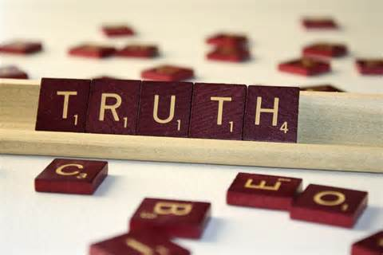
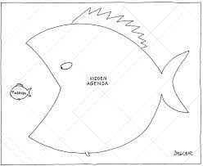
Implicit Contract
The REAL reason why the
client or patient is present.
Discovering the implicit contract is critical and one of the most decisive skills that the Biodyne Model has to offer.
It is also one of the most difficult Biodyne skills to master!
Provides direct insight & guidance on motivation/resistance perceptions
Notes:
Share personal experience in this regard (my reason for entering recovery…wanted fiancé back)- reflect on doing it intuitively and value of formal construct to help guide care process- sheds a helpful light on the idea of motivation/resistance

Slide 35
What for? The Implicit Contract
Notes:
Highlight the throwaway phrase at the door (see next slide)

Slide 36
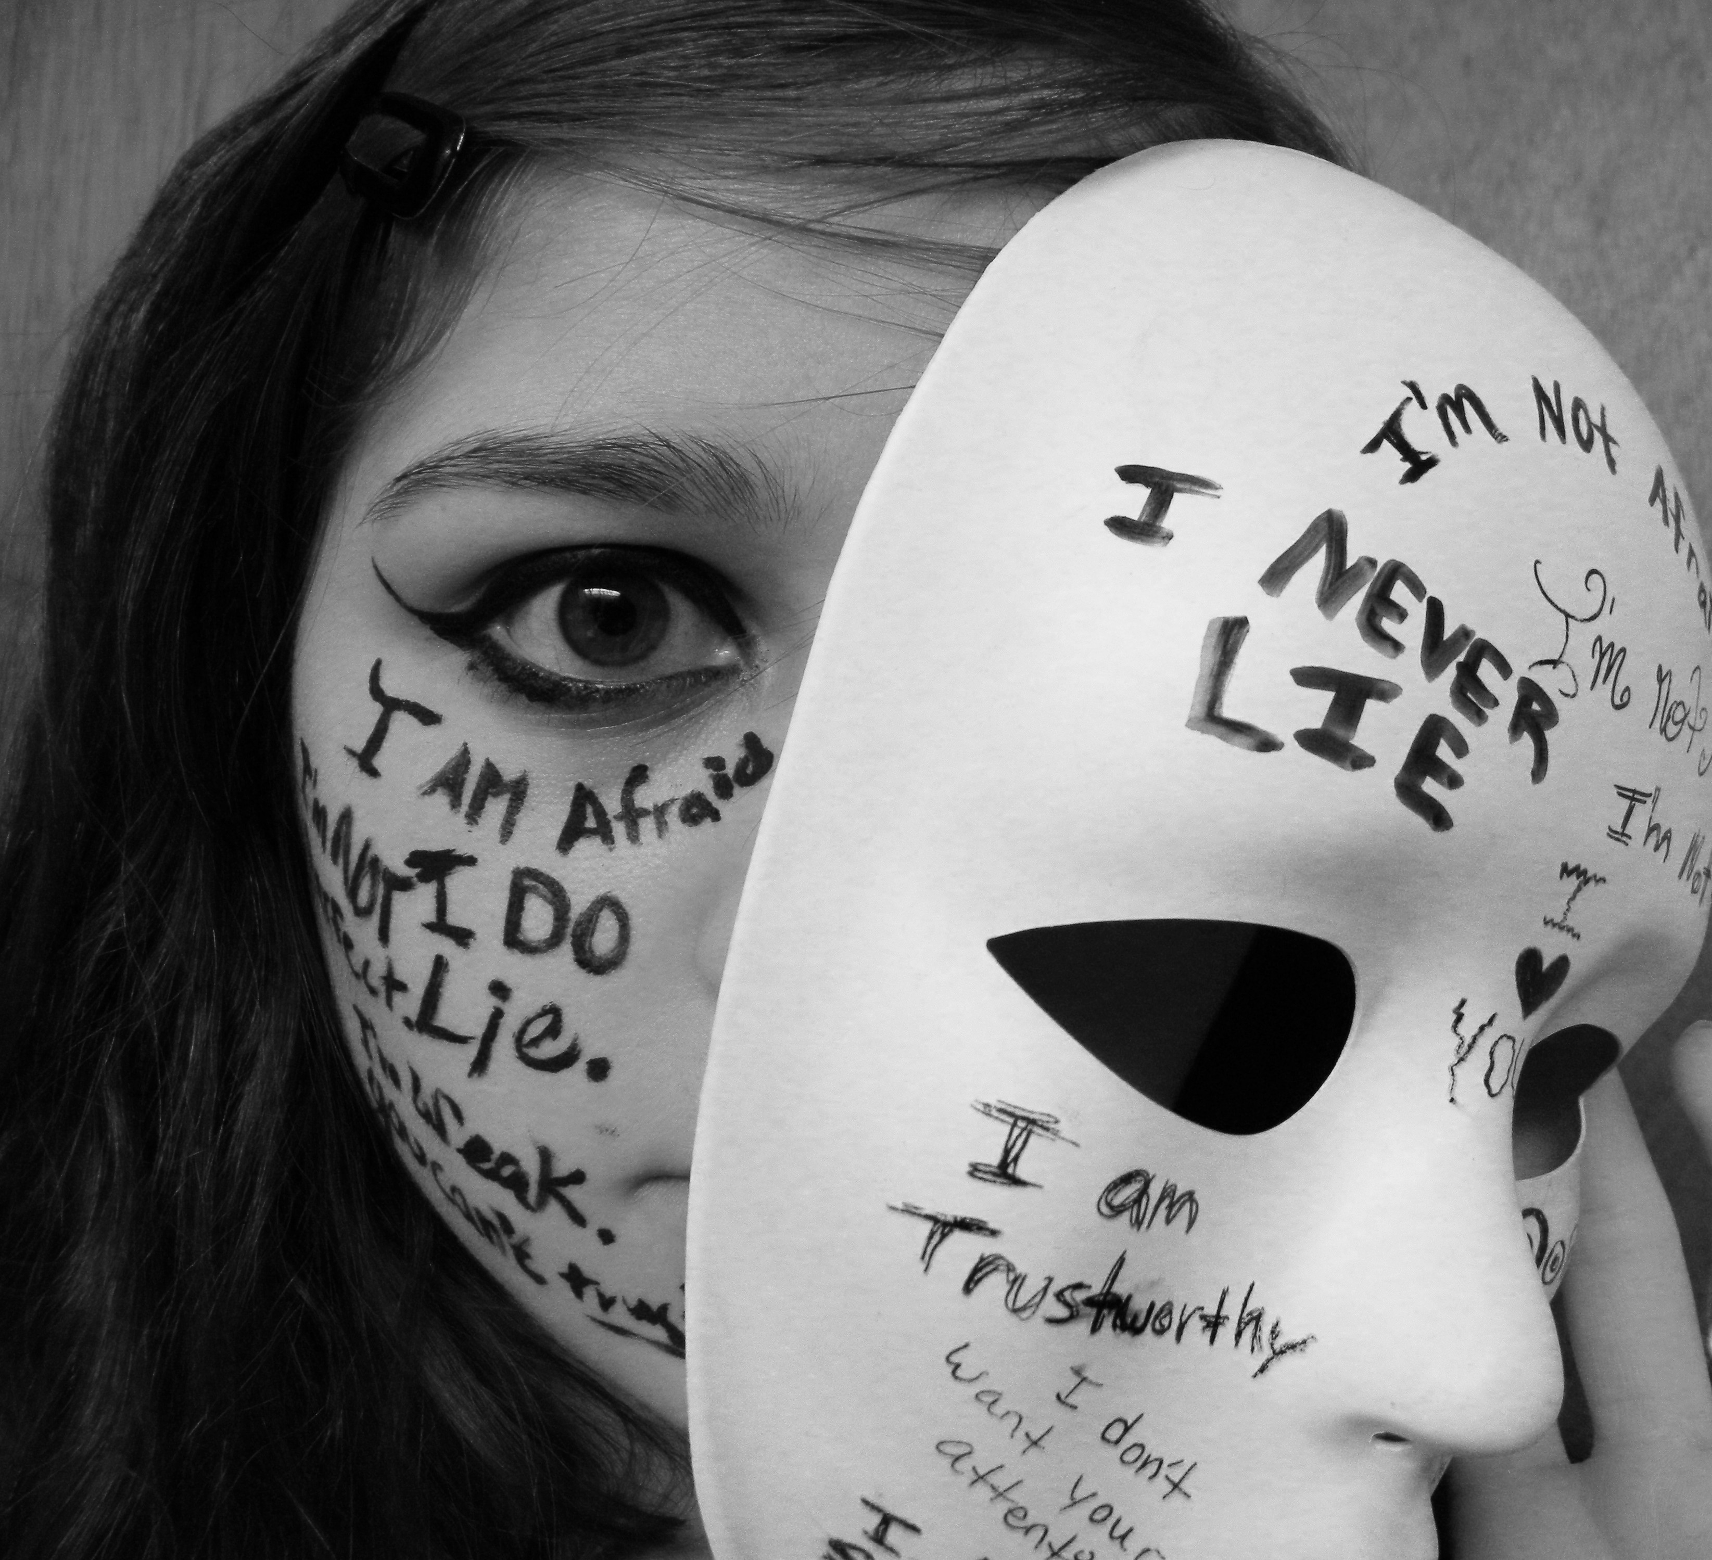
More About the Implicit Contract
Just when you think you have the real reason the patient is coming in, it will most often not be correct.
Figuring out the implicit contract can be one of the most elusive concepts in therapy.
The implicit contract always bears the resistance.
Notes:
Learned by most of us as children in response to authority. Child breaks vase, feels guilty, tells mother while she is distracted on the phone (“I told her”). Cummings gives an example of a patient who remarked, “Glad you have a comfortable office, I’ll be here a long time…” The diligent professional is focused on the explicit tale of woe being presented about stress, work etc.- may not recognize he has inadvertently made a contract for long term therapy to as an antidote to loneliness…!

Slide 37
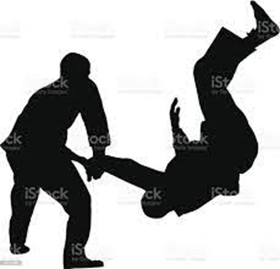
“Psychojudo”
“The Japanese martial art of judo can serve as an apt metaphor for psycho therapeutic intervention. The patients before us are in conflict with themselves. They cling to the neurotic modus operandi that has seemingly served them well in the past, yet this past salvation traps them in the present suffering. As time and events have progressed in their lives, the capacity to resolve developmental tasks and their accompanying tensions require new behaviors. The emerging problems of life require not only new resolutions, but usually more currently adaptive modes of curtailing anxiety”
(Refocused Psychotherapy, p. 35)
Notes:
Read- Biodyne expansion on MI “rolling w/ resistance”- MI may be part of the process.

Slide 38
Psychojudo
Notes:
Prescribing, humoring mobilizing rage, using internal language, overwhelming, joining delusion, denying treatment are all effective techniques requiring skill and balance. For example, use of humor can never be mocking or satiric. There is more to unpack here than time allows today but I’m happy to talk further about these areas after the presentation and there are a host of case studies available that illustrate these techniques in the Cummings text. A quick example of humoring= paranoid client calling treatment a “scam”; NC “humored” this allowing patient room to actually become a model client. Denying treatment is a frequent technique for those in the garlic/denial category (our clients)- all interventions offer client “room” to maneuver and help shift the resistance in a positive direction.

Slide 39
Ideal First Session
Notes:
Break the cycle of the “trained client”!

Slide 40
How? Therapeutic Contract

Slide 41
Notes:
Hard to believe we’ve reached the end of our time today. As mentioned earlier, one more point I want to emphasize.

Slide 42
2+ ___=4(?) “Intractable Addiction” (OSS-OPEN MINDS) v. Professional sustainability (Training, Supervision, self-care)
Notes:
We’ve been focused on the resistance of challenging clients. No matter what strategies we employ, if we are not at our best, we cannot last!

Slide 43
QUESTIONS AND ANSWERS
Notes:
Thank you for your time and attention. Take questions if time. Available after presentation if not. Copy of presentation/slides available through conference or me?

