Slide 1
Brain Functionality: ADD/ADHD & the Alcoholic Brain
Dr. Don Gilbert, MS, PhD, LMHC, BCPC

Slide 2
Subtyping ADD/ADHD: Looking at how the 7 subtypes impact the different parts of the brain
Learn the 7 subtypes associated with ADD/ADHD.
To understand what part(s) of the brain may be involved in each type.
To identify what each brain function impacts in everyday life.
To know what kind of treatment support may be used for each brain type dysfunction.

Slide 3
Subtyping the Alcoholic Brain: Looking at how the 6 subtypes impact the different parts of the brain
Learn the 6 subtypes associated with Alcoholism.
To understand what part(s) of the brain may be involved in each type.
To identify what each brain function impacts in everyday life.
To know what kind of treatment support may be useful for each subtype.

Slide 4
History of Brain Types
First started brain imaging work in 1991 (Dr Amen), looking for the 1 pattern associated with ADD/ADHD
Soon, clearly discovered … there was not one pattern associated with ADD/ADHD
There are multiple types- each with unique brain processing pattern that can be seen on SPECT scans
There is a continuum of dysfunction: mild--severe
Each is a brain processing dysfunction
This one idea led to dramatic breakthroughs in understanding and practice
He continues to do research into patterns in the brain related to anxiety, depression, addiction, and brain trauma
Dr. Amen

Slide 5
ADD is quite prevalent today, even though it has been known for many years
ADD is a Highly Genetic Disorder
The incidence of it in our culture has skyrocketed as a result of:
Food additives
Increase in TV watching
Internet
Highly stimulating video games
Decreased exercise

Slide 6
ADD people tend to be conflict-seeking which is a way to stimulate their own brains.
ADD kids can cause upset in the home by stirring up trouble to get an emotional reaction from a parent.
It’s better to respond to the child by being firm, but calm and kind rather than argue with or yell at the child.
Living in an ADD household can be very stressful

Slide 7
Dr. Amen considers ADHD one of the subtypes of ADD, because at least half of the people with ADD do not have hyperactivity.
Distractibility
Short attention span for routine tasks
Disorganization of time and space
Procrastination
Poor impulse control
SPECT scans show that for ADD people, blood flow decreases during concentration. This means the harder they try, the harder it gets.
Hallmark Symptoms of ADD

Slide 8
Through SPECT imaging Dr. Amen discovered there are 7 different types of ADD

Slide 9
7 Brain Types Associated with ADHD
1. Classic –
2. Inattentive –
3. Overfocused –
4. Limbic –
5. Temporal Lobe –
6. Ring of Fire – Hyper –
7. Anxious –
Courtesy Amen Clinics

Slide 10
7 Brain Types Associated with ADHD
Part of the brain that is impacted.
Can either be over-stimulated or under-stimulated.
1. Classic – PFC/CB – DA
2. Inattentive – PFC/CB – DA
3. Overfocused – AC/PFC – DA/S
4. Limbic – Limbic/PFC – NE/DA
5. Temporal Lobe – TLs/PFC – DA/GABA
6. Ring of Fire – Hyper – GABA, S and DA
7. Anxious – GABA, DA
Courtesy Amen Clinics

Slide 11
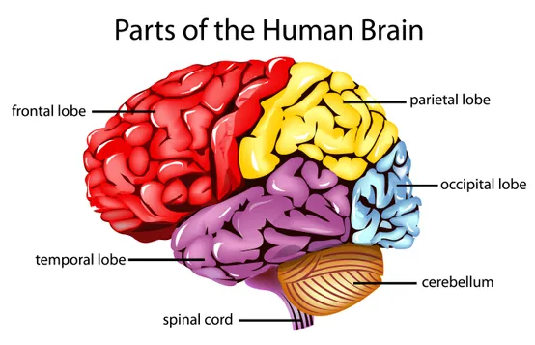

Slide 12
AC-Anterior Cingulate - The anterior cingulate cortex (ACC) lies in a unique position in the brain, with connections to both the “emotional” limbic system and the “cognitive” prefrontal cortex.
BG- Basal Ganglia- The basal ganglia is a cluster of nuclei found deep to the neocortex of the brain. It has a multitude of functions associated with reward.
TL's- Temporal Lobes - The main functions of the temporal lobes include understanding language, memory acquisition, face recognition, object recognition, perception and processing auditory information.
Part of the brain that is impacted. Can either be over-stimulated or under-stimulated.
Notes:
. Thus, the ACC likely has an important role in integration of neuronal circuitry for affect regulation and can be identified as a distinctive region in understanding psychopathology. Affect-regulation, the ability to control and manage uncomfortable emotions, is a primary goal for mental health clinicians in treating psychopathology.7 Avoidance of painful emotions is often the motivating force in negative behaviors such as substance abuse, binge eating, and suicide. These actions are taken as part of maladaptive approaches to control, avoid, or regulate painful emotions. Clinicians often treat patients by helping them to develop more adaptive coping mechanisms in regulating their emotions. Understanding the processes by which ACC contributes to regulation of emotions may assist clinicians in their therapeutic work.
The left temporal lobe, which is typically the most dominant in people, is associated with understanding language, learning, memorizing, forming speech and remembering verbal information.
The right temporal lobe, which is typically the least dominant in people, is associated with learning and memorizing non-verbal information (e.g. drawings and music), recognizing information, and determining facial expressions.
Essentially, the temporal lobes interact with, and depend upon input, which can be from other brain regions, as well as from sensory input from the environment. The temporal lobes can convert sounds into visual images in the mind. We also would not be able to understand someone talking to us without the use of our temporal lobes helping us to make sense of language.

Slide 13
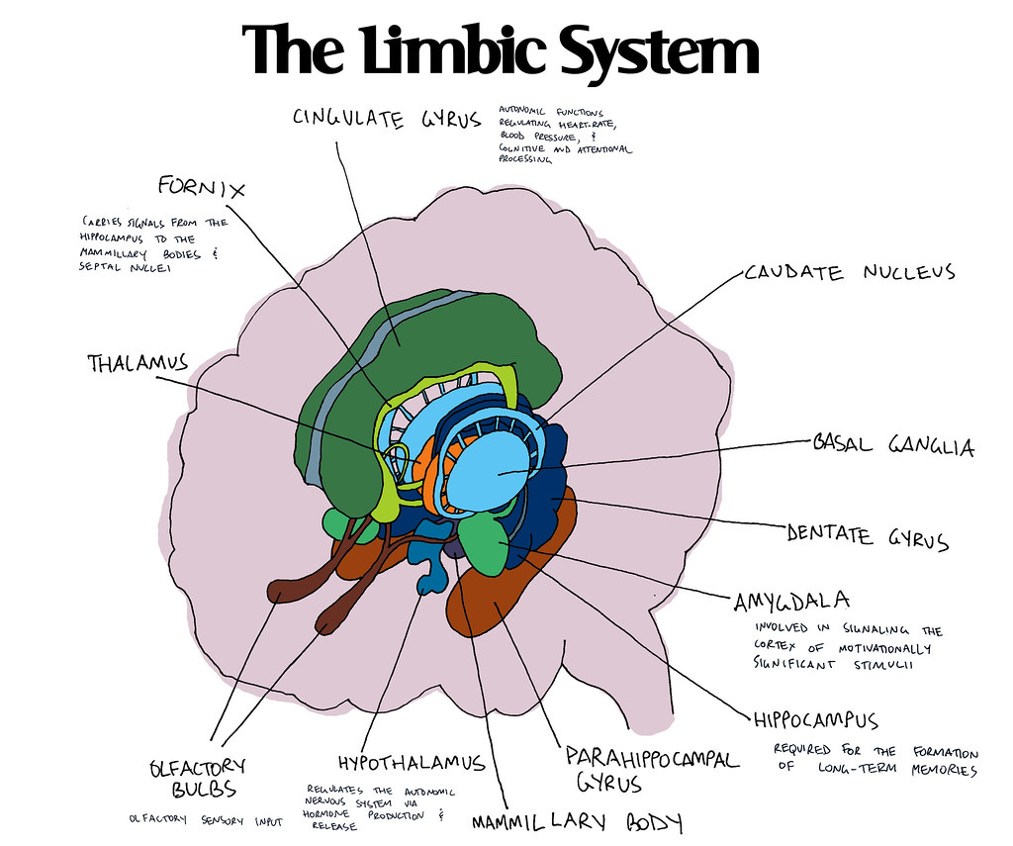
Part of the brain that is impacted. Can either be over-stimulated or under-stimulated.
PFC-prefrontal cortex - The prefrontal cortex is a part of the brain located at the front of the frontal lobe. It is implicated in a variety of complex behaviors, including planning, and greatly contributes to personality development
CB –Cerebellum: The cerebellum, which stands for ‘little brain’, is a hindbrain structure that controls balance, coordination, movement, and motor skills
GABA-Gamma aminobutyric acid (GABA) is a naturally occurring amino acid that works as a neurotransmitter in your brain.
Notes:
The prefrontal cortex helps people set and achieve goals. It receives input from multiple regions of the brain to process information and adapts accordingly. The prefrontal cortex contributes to a wide variety of executive functions, including:
Focusing one’s attention
Predicting the consequences of one’s actions; anticipating events in the environment
Impulse control; managing emotional reactions
Planning for the future
Coordinating and adjusting complex behaviors (“I can’t do A until B happens”)
The brain develops in a back to front pattern, and the prefrontal cortex is the last portion of the brain to fully develop. This does not mean that children do not have functional prefrontal cortices. Rather, they do not develop the complex decision-making and planning skills adults have until they are older.
During adolescence, the brain’s network of neurons develops many more synapses. These connections increase communication between parts of the brain and allow the individual to learn complex skills. However, this growth may happen unevenly.
For example, most fifteen-year-olds can assess hypothetical risk as well as adults. However, a teen’s prefrontal cortex has not grown many connections with the limbic system yet. In other words, the part of the brain that provides self-control can’t communicate well with the part of the brain that controls the fight or flight response. Thus, the same fifteen-year-old may act rashly under stress, even if they technically “know better.”
In general, though, the prefrontal cortex can be divided into three parts according to which functions they serve.
The medial prefrontal cortex contributes to attention and motivation. It can be thought of as a metaphorical start button, allowing people to begin an activity when it is time to do so. Lesions (i.e. injuries) in this area cause people to become apathetic and unfocused. They may have trouble acting spontaneously or initiating speech. They could also have trouble concentrating on a task once it has started.
The orbital prefrontal cortex helps people control their impulses and ignore distractions. It helps them keep strong emotions in check in order to follow social rules. In one famous case, a man named Phineas Gage got an iron rod blown through his skull, injuring this area. Gage survived but displayed significant changes to his personality. He became irritable and reckless, growing prone to inappropriately crude humor. Research shows such changes are common when the orbital prefrontal cortex is injured.
Lastly, the lateral prefrontal cortex allows people to create and execute plans. This region also helps individuals organize actions in a certain sequence, such as when a person needs to follow a recipe. Injuries to this region can interfere with people’s abilities to switch between tasks, recall where an instruction came from, or adapt to changes in rules.

Slide 14
DA-Dopamine- naturally occurring neurotransmitter that, among other functions, helps maintain coordination of voluntary muscle movement. It also plays a role in regulating emotions, behavior, motivation, and feelings of pleasure and reward.
NE- Norepinephrine- A naturally occurring neurotransmitter made from dopamine. It can act as both a stress hormone and neurotransmitter. As part of the body's response to stress, norepinephrine affects the way the brain pays attention and responds to events.
S- Serotonin- naturally occurring neurotransmitter that is involved with mood and anxiety regulation, sexual function, and digestion
Part of the brain that is impacted: Neurotransmitters
Notes:
. Thus, the ACC likely has an important role in integration of neuronal circuitry for affect regulation and can be identified as a distinctive region in understanding psychopathology. Affect-regulation, the ability to control and manage uncomfortable emotions, is a primary goal for mental health clinicians in treating psychopathology.7 Avoidance of painful emotions is often the motivating force in negative behaviors such as substance abuse, binge eating, and suicide. These actions are taken as part of maladaptive approaches to control, avoid, or regulate painful emotions. Clinicians often treat patients by helping them to develop more adaptive coping mechanisms in regulating their emotions. Understanding the processes by which ACC contributes to regulation of emotions may assist clinicians in their therapeutic work.
The left temporal lobe, which is typically the most dominant in people, is associated with understanding language, learning, memorizing, forming speech and remembering verbal information.
The right temporal lobe, which is typically the least dominant in people, is associated with learning and memorizing non-verbal information (e.g. drawings and music), recognizing information, and determining facial expressions.
Essentially, the temporal lobes interact with, and depend upon input, which can be from other brain regions, as well as from sensory input from the environment. The temporal lobes can convert sounds into visual images in the mind. We also would not be able to understand someone talking to us without the use of our temporal lobes helping us to make sense of language.

Slide 15
Neurotransmitters and ADD
DA- Dopamine - focus and motivation
NE- Norepinephrine – focus, alertness and sleep-wake cycle
S- Serotonin - mood, sleep and shifting attention
GABA - calms the brain

Slide 16
The Limbic System
Located deeper in the brain, this system regulates emotions. A deficiency in this region might result in restlessness, inattention, or emotional volatility.
This Photo by Unknown author is licensed under CC BY-SA-NC.
Notes:
supports a variety of functions including emotion, behavior, long-term memory, and olfaction.[2] Emotional life is largely housed in the limbic system, and it critically aids the formation of memories.
The structures and interacting areas of the limbic system are involved in motivation, emotion, learning, and memory. The limbic system is where the subcortical structures meet the cerebral cortex.[1] The limbic system operates by influencing the endocrine system and the autonomic nervous system. It is highly interconnected with the nucleus accumbens, which plays a role in sexual arousal and the "high" derived from certain recreational drugs.

Slide 17
Low dopamine
Short attention span
Distractibility
Disorganization
Procrastination
Poor impulse control
Restless and hyperactive
Talking too much & interrupting
Type 1
Classic ADD
Courtesy Amen Clinics

Slide 18
Support Dopamine
Stimulant medications or supplements
L-Tyrosine: a building block for dopamine
EPA fish oil
Specific diet: higher protein/lower carbohydrate
Intense aerobic exercise
Limiting TV and video games
Type 1
Classic ADD
Support
Courtesy Amen Clinics

Slide 19
Short attention span
Distractibility
Procrastination
Poor impulse control
Typically diagnosed later than Type 1 because behaviors aren’t as overt
Spacey and often underachievers
Type 2
Inattentive ADD
Courtesy Amen Clinics

Slide 20
Support Dopamine
Stimulant medications or supplements
L-Tyrosine: a building block for dopamine
EPA fish oil
Specific diet: higher protein/lower carbohydrate
Intense aerobic exercise
Limiting TV and video games
Type 2
Inattentive ADD
Support
Courtesy Amen Clinics

Slide 21
In addition to classic ADD symptoms, they tend to be rigid, inflexible, and get stuck on negative thoughts or behaviors.
Type 3
Overfocused ADD
Trouble shifting attention
Stuck in loops of thinking
Low serotonin & dopamine
Excessive anterior cingulate activity
Courtesy Amen Clinics

Slide 22
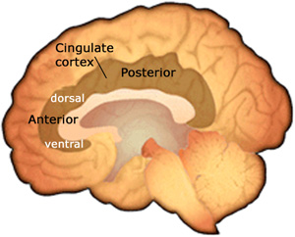
Brain’s gear shifter
Go from task to task
Move from idea to idea
Be flexible
Go with the flow
Error detection
Type 3
Overfocused ADD
Anterior Cingulate Gyrus
FUNCTION

Slide 23
Tend to get stuck
Worry
Hold Grudges
Upset if things don’t go their way
Argumentative, oppositional
See to many errors
Family members also get stuck
Type 3
Overfocused ADD
Courtesy Amen Clinics

Slide 24
Supplements or medications to support serotonin and dopamine
EPA/DHA fish oil
Balanced diet: higher carbohydrate
Does NOT do well on high protein diet
Increase exercise
Limiting TV and video games
Type 3
Overfocused ADD
Support
Courtesy Amen Clinics

Slide 25
Hallmark ADD Symptoms
Distractibility
Short attention span for routine tasks
Disorganization of time and space
Procrastination
Poor impulse control
May or may not be hyperactive
Sad
Negative
Glass half empty
Poor appetite and sleep
More socially isolated
Type 4
Limbic ADD
Courtesy Amen Clinics

Slide 26
The Limbic System
Located deeper in the brain, this system regulates emotions. A deficiency in this region might result in restlessness, inattention, or emotional volatility.
This Photo by Unknown author is licensed under CC BY-SA-NC.
Notes:
supports a variety of functions including emotion, behavior, long-term memory, and olfaction.[2] Emotional life is largely housed in the limbic system, and it critically aids the formation of memories.
The structures and interacting areas of the limbic system are involved in motivation, emotion, learning, and memory. The limbic system is where the subcortical structures meet the cerebral cortex.[1] The limbic system operates by influencing the endocrine system and the autonomic nervous system. It is highly interconnected with the nucleus accumbens, which plays a role in sexual arousal and the "high" derived from certain recreational drugs.

Slide 27
Stimulant medications or supplements that support Dopamine and Norepinephrine
Multivitamin
EPA/DHA balanced fish oil
SAM-e
Increase exercise
Limiting TV and video games
Type 4
Limbic ADD
Support
Courtesy Amen Clinics

Slide 28
Hallmark ADD Symptoms
Distractibility
Short attentions span for routine tasks
Disorganization of time and space
Procrastination
Poor impulse control
May or may not have hyperactivity
Temporal Lobe Symptoms
Learning: reading or language problems
Memory: illusions and déjà vu
Temper outbursts, moody, irritable
Type 5
Temporal Lobe ADD
Courtesy Amen Clinics

Slide 30
Medications or supplements to boost GABA and stabilize the temporal lobes
Anticonvulsant medication can be helpful
Multivitamins
EPA/DHA balanced fish oil
Then something to boost dopamine to help focus
IN THAT ORDER!
Possibly ketogenic diet
Higher protein & healthy fat- eliminate all simple sugars
Increase exercise
Avoid all violent video games and TV
Type 5
Temporal Lobe ADD
Support
Courtesy Amen Clinics

Slide 31
Hallmark ADD Symptoms
Easily distracted
Short attention span for routine tasks
Disorganization of time and space
Procrastination
Poor impulse control
Restlessness and Hyperactivity
Moody
Too many thoughts
Overly sensitive to lights, sounds, & touch
Type 6
Ring of Fire ADD
Courtesy Amen Clinics

Slide 32
Early Bipolar Disorder
Allergies
Inflammation
Type 6
Ring of Fire ADD
Possible Causes

Slide 33
Stimulants typically make them worse
Supplements or medication to calm the brain and support GABA & Serotonin
Multivitamin
Fish oil
Combination of GABA, 5HTP & L-Tyrosine
Special, balanced diet
Increase exercise
Limit TV and video games
Type 6
Ring of Fire ADD
Support
Courtesy Amen Clinics

Slide 34
Hallmark ADD Symptoms
Distractibility
Short attentions span for routine tasks
Disorganization of time and space
Procrastination
Poor impulse control
Anxious
Nervous
Tense
Predict the Worst
Type 7
Anxious ADD
Courtesy Amen Clinics

Slide 35
Support GABA & Dopamine
Stimulants alone increase anxiety
Deep relaxation techniques
Grounding techniques
Type 7
Anxious ADD
Support
Courtesy Amen Clinics

Slide 37
Research indicates that:
75% of people with ADD have interpersonal problems
52% have problems with drugs or alcohol

Slide 38
6 Brain Types Associated with Substance Abuse
1. Impulsive –
2. Compulsive –
3. Impulsive-Compulsive –
4. Sad –
5. Anxious –
6. Temporal Lobe –

Slide 39
6 Brain Types Associated with Substance Abuse
Part of the brain that is impacted.
1. Impulsive – PFC -DA
2. Compulsive – AC - S
3. Impulsive-Compulsive – AC/PFC –DA/S
4. Sad – Limbic – DA/NE
5. Anxious – BG - GABA
6. Temporal Lobe – TLs - GABA

Slide 40
Low prefrontal cortex (PFC) activity
Tend to abuse stimulants, smoke & drink caffeine
Easily distracted and use stimulants to activate the PFC
Type 1
Impulsive
Substance Abuse

Slide 41
High Cingulate activity; obsessed with drug of choice
The issue here is the part of the brain that is responsible for compulsivity
Could be any or many substances
They usually are thinking about their drug of choice and are driven without a sense of control
Type 2
Compulsive
Substance Abuse

Slide 42
Low prefrontal cortex (PFC) with high anterior cingulate gyrus (ACG) activity
Craves substances that mimic dopamine and serotonin
Combination of Type 1 & 2
Do use stimulants to activate the brain and can use substances to calm their moods
Type 3
Impulsive- Compulsive
Substance Abuse

Slide 43
Anterior Cingulate -The anterior cingulate cortex (ACC) lies in a unique position in the brain, with connections to both the “emotional” limbic system and the “cognitive” prefrontal cortex.
The Anterior Cingulate Gyrus (ACG) functions as brain’s gear shifter

Slide 44
Use Substances to try and escape mood problems
Overactive limbic activity
Tendency to medicate feelings with depressant type drugs including food
Normally have a tendency toward SADD with decreased Vitamin D levels during the winter months
This can interfere with the hormone leptin that tells us when to stop eating
Type 4
Sad Addicts
Substance Abuse

Slide 45
Use Substances to calm anxieties
Pot, alcohol, smoking, food
Can be anxious about being anxious
Type 5
Anxious Addicts
Substance Abuse

Slide 46
Pure anxiety: High activity in the basal ganglia
Pure depression: High activity in the limbic area
Mixed anxiety and depression: High activity in the basal ganglia and limbic area
Overfocused: High activity in the anterior cingulate and limbic area
Cyclic: Common in bipolar patients
Temporal lobe: Mood instability and temper problems - likely stemming from traumatic brain injury but possibly mislabeled as bipolar
Unfocused: Overall low activity, possibly due to toxin exposure, infection, or anoxic injuries
7 Brain types associated with
ANXIETY

Slide 47
Substance abuse often occurs after a TBI- traumatic brain injury
Processing and memory problems
Tend to get violent after drinking
Type 6
Temporal Lobe
Substance Abuse

Slide 48
A person with a mild TBI may experience any of the following:
Headache
Confusion
Lightheadedness
Dizziness
Blurred vision
Ringing in the ears, also known as tinnitus
Tiredness or sleepiness
A bad taste in the mouth
A change in sleep habits
Behavior or mood changes
Trouble with memory, concentration, attention, or thinking
Loss of consciousness lasting a few seconds to minutes¹
Sensitivity to light or sound
Nausea or vomiting²
TBI
Mild Symptoms
Substance Abuse

Slide 49
A person with moderate or severe TBI may experience any of the following:
Headache that gets worse or will not go away
Loss of vision in one or both eyes
Repeated vomiting or continued nausea
Slurred speech
Convulsions or seizures
An inability to wake up from sleep
Enlargement of the pupil (dark center) of one or both eyes
Numbness or tingling of arms or legs
Uncoordinated or “clumsy” movements
Increased confusion, restlessness, or agitation
Loss of consciousness lasting a few minutes to hours³
A person who suffers a blow to the head or other injury that may cause a TBI should seek medical attention, even if none of the symptoms listed are present.⁴ Sometimes symptoms do not appear until well after the injury.
TBI
Moderate or Severe Symptoms
Substance Abuse

Slide 51
CONCLUSION
You have learned the 7 subtypes associated with ADD/ADHD.
You can understand what part(s) of the brain may be involved in each type.
You can identify what each brain function impacts in everyday life.
You now know what kind of treatment support may be used for each brain type dysfunction.

Slide 52
CONCLUSION
We have learned the 6 brain subtypes associated with Alcoholism.
You can understand what part(s) of the brain may be involved in each type.
You can now identify what each brain function impacts in everyday life.
You now know what kind of treatment support may be useful for each subtype.

