Slide 1
You’re Addicted to What? Examining the Intersection of Process Addictions and Mental Health
Thad Shunkwiler, LMFT, LPCC, ACS, CCMHC, NCC
Associate Professor
College of Allied Health and Nursing
Director: Center for Rural Behavioral Health
Minnesota State University, Mankato

Slide 2
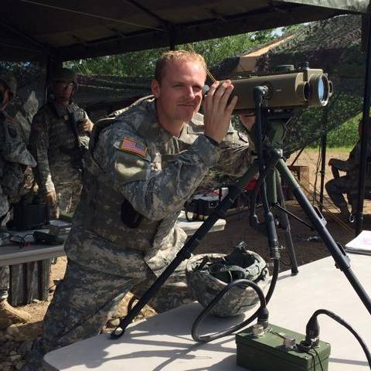
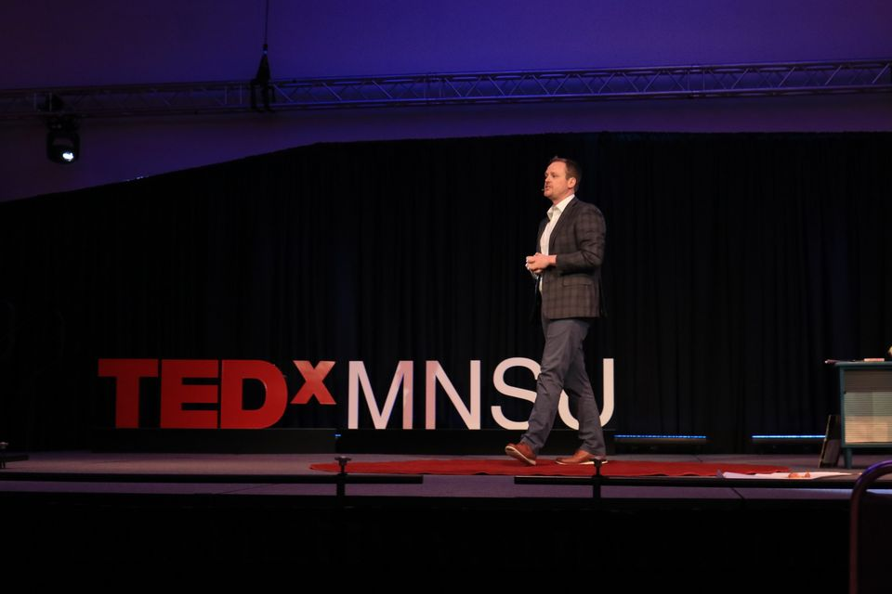
Introductions
Who am I?
Why this topic?

Slide 3
Disclaimer
The information in this presentation is for educational purposes only and is the sole opinion of the presenter.
Notes:
THAD

Slide 4
Learning Objectives
Identify the pathology and presumed etiology of process addictions
Examine the co-occurring nature of process addictions, chemical addictions, and mental health
Explore treatment modalities to intervene on process addictions
Goal: Information to enhance your clinical knowledge and practice

Slide 5
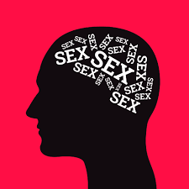
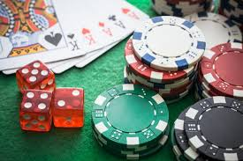
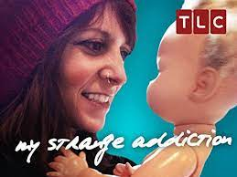
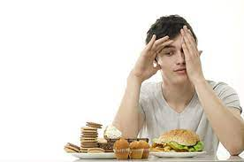
Your beliefs on process addiction.
Notes:
How much sex is too much? The DSM-5 workgroup couldn’t decide and therefore left it out of any discussion of sex addiction.

Slide 6
Your experience with process addictions?

Slide 7
Process Addictions Defined
While considerable efforts have been made to understand the neurobiological basis of substance addiction, the potentially ‘addictive’ qualities of repetitive behaviors, and whether such behaviors constitute ‘behavioral addictions’, is relatively neglected. - (Grant, 2017)

Slide 8
American Society of Addiction Medicine
“Addiction is a treatable, chronic medical disease involving complex interactions among brain circuits, genetics, the environment, and an individual’s life experiences. People with addiction use substances or engage in behaviors that become compulsive and often continue despite harmful consequences.”

Slide 9
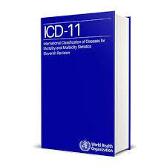
ICD-11: Disorders Due to Addictive Behaviors
Disorders due to addictive behaviors are recognizable and clinically significant syndromes associated with distress or interference with personal functions that develop as a result of repetitive rewarding behaviors other than the use of dependence-producing substances.
Disorders due to addictive behaviors include gambling disorder and gaming disorder.

Slide 10
Mental Health Disorders- DSM 5
A mental health disorder suggests the defining features are:
a behavioral or psychological syndrome or pattern that occurs in an individual;
the consequences of which are clinically significant distress;
not merely an expectable response to common stressors and losses;
reflects an underlying psychobiological dysfunction;
is not solely a result of social deviance or conflicts with society;
has diagnostic validity using one or more sets of diagnostic validators;
Important to note that gambling disorder was included in the DSM-V when the chapter on addictions was changed from “Substance-Related Disorders” to ”Substance-Related and Addictive Disorders.”

Slide 11
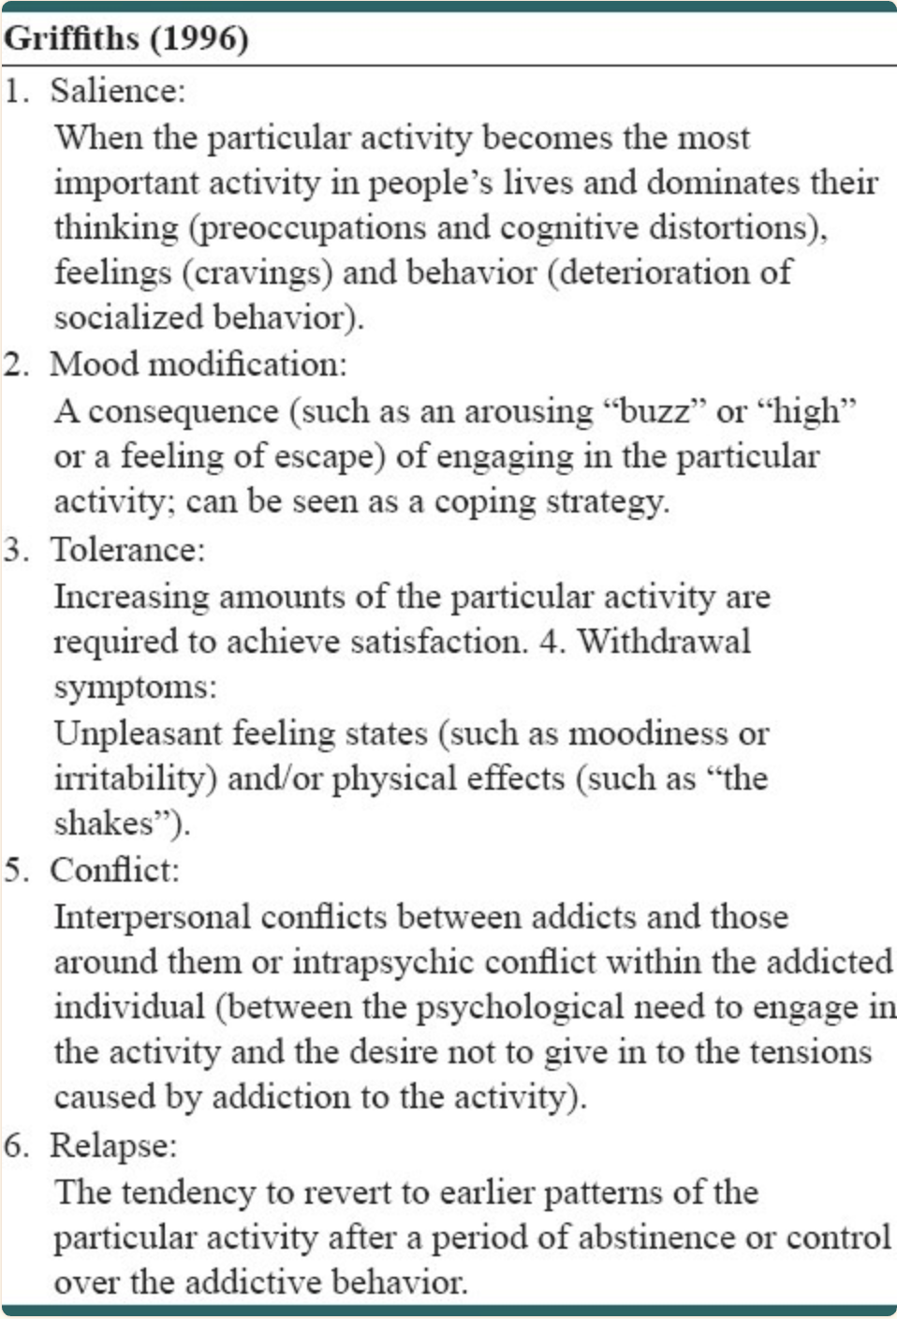
Mark Griffiths (1996)
Behavior Addiction:
“the whole is easier to recognize. than the parts”
Six components to determine if a behavior is an addiction.

Slide 12
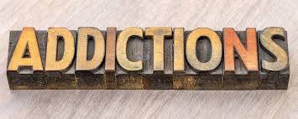
Common Process Addictions
Gambling *
Sex
Internet (Social Media)
Shopping
Video Game*
Plastic Surgery
Food (Binge Eating Disorder)*
Risky Behavior
*indicates current DSM/ICD diagnosis

Slide 13
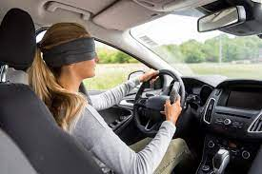
Where do they come from?
“Providing treatment before fully understanding the etiology of a pathology is like driving a car on the interstate wearing blindfold.” (Shunkwiler, 2019)

Slide 14
Where do they come from?
Impulse Control Hypothesis
The core feature of these behaviors as well as substance use disorders appears to be impulsivity. Impulse control disorders primarily involve a pleasant sensation quality—sex, gambling and stealing are all associated with a rush or a high (Grant, Brewer & Potenza 2006).
Critics argue that behavioral conditions are simply secondary manifestations of underlying psychiatric illnesses including mood disorders, anxiety disorders, ADHD, personality disorders and other disorders. The repetitive behavior is simply an adaptation or compulsion to avoid discomfort. (Karim, 2012)

Slide 15
Where do they come from?
Biopsychosocial Hypothesis
The biopsychosocial model of addiction states that genetic/ biological, psychological, and sociocultural factors contribute to addiction and should be taken into account for its prevention and treatment. (Skewes & González, 2013)
Criticism against the model include: the dominance or under-representation of each of the three domains (bio-, psycho- or social) when applied to research and clinical practice, and the insensitivity of the model to individuals’ ‘personal meaning’, particularly within cross-cultural settings. (Decon, 2013)

Slide 16
Co-Occurrence of Process Addictions and other Psychological Disorders
What has been your clinical experience with the intersection of process addiction, substance use, and mental health disorders?

Slide 17
Co-Occurrence of Process Addictions and other Psychological Disorders
The essential feature of behavioral addictions is the failure to resist an impulse, drive, or temptation to perform an act that is harmful to the person or to others. In this respect, the behavioral addictions resemble substance use disorders. – (Grant, 2010)
Many people with pathological gambling, compulsive sexual behavior, and compulsive buying report a decrease in positive mood effects with repeated behaviors and a need to increase the intensity of behavior to achieve the same mood effect, similar to tolerance of a substance. – (Grant, 2010)

Slide 18
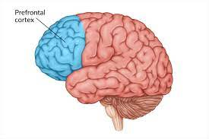
Co-Occurrence of Process Addictions and other Psychological Disorders
Some evidence from neuroimaging studies supports a shared neurocircuitry of gambling disorder and substance use disorders. (Brewer, 2008)
Abnormal functioning of the prefrontal cortex has been associated with gambling and substance addictions, and diminished cortex activation has also been implicated in the cravings associated with gambling and substance addictions. (Grant, 2017)

Slide 19
Co-Occurrence of Process Addictions and other Psychological Disorders
The St. Louis Epidemiologic Catchment Area (ECA) study found high rates of co-occurrence for substance use disorders and pathological gambling, with the highest ratios generally observed between gambling, alcohol use disorders. (Cunningam, 1998)
A Canadian epidemiological survey estimated that the relative risk for an alcohol use disorder increased 3.8-fold when disordered gambling was present. (Bland, 1993)
Internet addiction was associated with harmful alcohol use (nearly 2x) in a study of 2,453 college students, after controlling for gender, age and depression. (Yen, 2009)

Slide 20
Co-Occurrence of Process Addictions and other Psychological Disorders
(Grant, 2010)

Slide 21
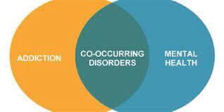
Co-Occurrence of Process Addictions and other Psychological Disorders
Other psychiatric disorders, such as major depressive disorder, bipolar disorder, obsessive compulsive disorder, and attention deficit hyperactivity disorder, are also commonly reported in association with behavioral addictions. (Di Nicola, 2010)

Slide 22
Treatment (Non-Pharmacological)
Psychodynamic
Clinicians seek to understand the basis of all human behaviors by considering the motivational forces that derive from unconscious mental processes. (Wong, 1989)
This perspective suggests that the process addiction is a symptom or expression of an underlying psychological condition.
Limited empirical research on its overall effectiveness.
Cognitive Behavioral Therapy
Cognitive treatment aims to counteract underlying irrational beliefs and attitudes about gambling that are believed to initiate and maintain the undesirable behavior. (Gaboury and Ladouceur, 1989)
Cognitive-behavioral approaches have been successful for both adolescent problem gamblers (Ladouceur et al., 1994) and adult pathological gamblers (Sylvain et al., 1997).
Often viewed as an easier approach to teach due to its operational orientation.

Slide 23
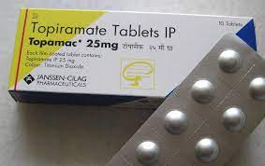
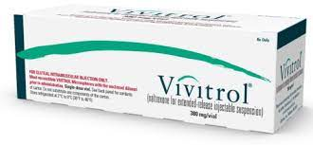
Treatment (Psychotropic)
Naltrexone (Vivitrol) has been reported to reduce craving in pathological gamblers (Grant et al. 2006).
Naltrexone (Vivitrol) has also shown promise in the treatment of compulsive sexual behavior (Grant & Kim 2001).
Topirimate (Topamax) is an anticonvulsant and has shows some success in reducing binge episodes (McElroy et al. 2007).

Slide 24
Treatment Challenges
Difficulty in getting third party payment for process addiction as primary condition.
Stigma associated with process addictions.
Lack of understanding among healthcare professionals.

Slide 25
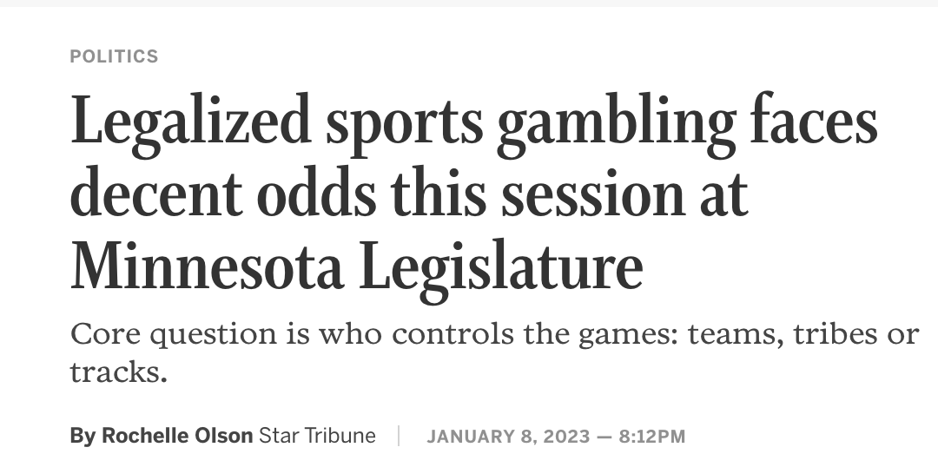
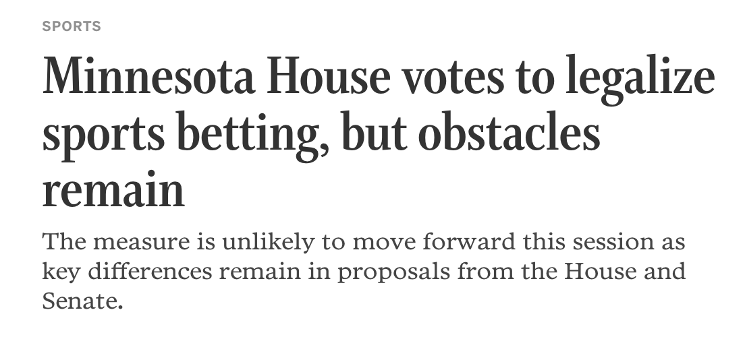
Legalized Sports Betting- It’s coming, so what does that mean?

Slide 26
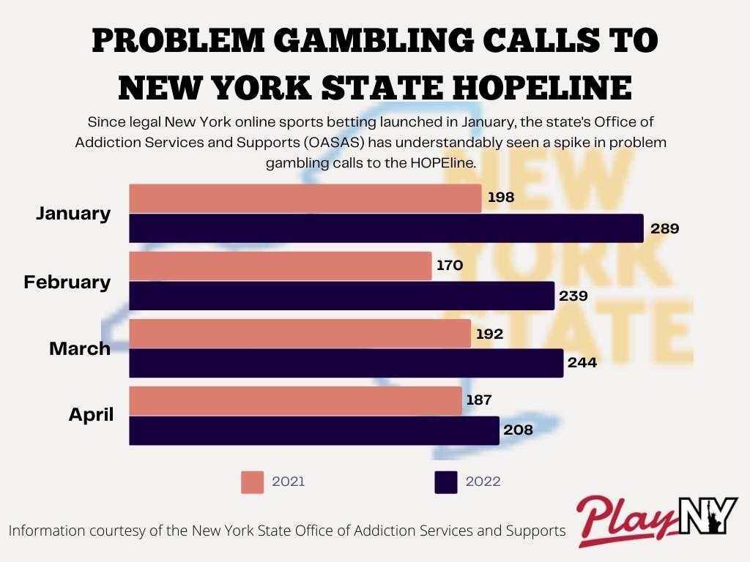
Legalized Sports Betting- It’s coming, so what does that mean?

Slide 27
Case Study:

Slide 28
Mission:
The Center for Rural Behavioral Health at Minnesota State University, Mankato is dedicated to improving access to behavioral healthcare for residents in outstate Minnesota to include recognized Reservations/Settlements through research, workforce development, and continuing education.
Upcoming Events:
April 14th and 28th: Advanced Clinical Supervisor Training (Rashida Fisher and Tamara Kaiser)
May 18/19 and June 15/16: Foundational Clinical Supervisor Training

Slide 29
Questions?
Thad.Shunkwiler@mnsu.edu

Slide 30
References:
Bland RC, Newman SC, Orn H, Stebelsky G. Epidemiology of pathological gambling in Edmonton. Can J Psychiatry. 1993 Mar;38(2):108-12. doi: 10.1177/070674379303800207. PMID: 8467435.
Brewer JA, Potenza MN. The neurobiology and genetics of impulse control disorders: Relationships to drug addictions. Biochem Pharmacol. 2008;75(1):63–75.
Deacon BJ. The biomedical model of mental disorder: a critical analysis of its validity, utility, and effects on psychotherapy research. Clin Psychol Rev. 2013 Nov;33(7):846-61. doi: 10.1016/j.cpr.2012.09.007. Epub 2013 Apr 8. PMID: 23664634.
du Hoffmann J, Nicola SM. Dopamine invigorates reward seeking by promoting cue-evoked excitation in the nucleus accumbens. J Neurosci. 2014 Oct 22;34(43):14349-64. doi: 10.1523/JNEUROSCI.3492-14.2014. PMID: 25339748; PMCID: PMC4205557.
Karim R, Chaudhri P. Behavioral addictions: an overview. J Psychoactive Drugs. 2012 Jan-Mar;44(1):5-17. doi: 10.1080/02791072.2012.662859. PMID: 22641961.
Ladouceur, R., & Gaboury, A. (1988). Effects of limited and unlimited stakes on gambling behavior. Journal of Gambling Behavior, 4(2), 119–126.
Grant JE, Potenza MN, Hollander E, Cunningham-Williams R, Nurminen T, Smits G, Kallio A. A multicenter investigation of the opioid antagonist nalmefene in the treatment of pathological gambling. Am J Psychiatry.2006;163(2):303–312.
Grant JE, Kim SW, Hartman BK. A double-blind, placebo-controlled study of the opiate antagonist, naltrexone, for the treatment of pathological gambling urges. J Clin Psychiatry. 2008;69(5):783–789.
Grant, J. E., Brewer, J. A., & Potenza, M. N. (2006). The Neurobiology of Substance and Behavioral Addictions. CNS Spectrums, 11, 924-930.
McElroy SL, Hudson JI, Capece JA, Beyers K, Fisher AC, Rosenthal NR et al (2007. b). Topiramate for the treatment of binge eating disorder associated with obesity: a placebo-controlled study. Biol Psychiatry 61: 1039–1048.
Skewes, M.C., & Gonzalez, V.M. (2013). The Biopsychosocial Model of Addiction.
Sylvain C, Ladouceur R, Boisvert JM. Cognitive and behavioral treatment of pathological gambling: a controlled study. J Consult Clin Psychol. 1997 Oct;65(5):727-32. doi: 10.1037//0022-006x.65.5.727. PMID: 9337491.
Wong, P. T. (1989). Personal meaning and successful aging. Canadian Psychology / Psychologie canadienne, 30(3), 516–525.
Yen CF, Ko CH, Yen JY, Chang YP, Cheng CP. Multi-dimensional discriminative factors for Internet addiction among adolescents regarding gender and age. Psychiatry Clin Neurosci. 2009 Jun;63(3):357-64. doi: 10.1111/j.1440-1819.2009.01969.x. PMID: 19566768.

