Slide 1
Self-care is not selfish: The science of emotional wellness and why you deserve it too!
Dr. Jennifer Londgren, LMFT, NCC, BC-TMH
10th Annual Co-Occurring Disorders Symposium
January 27th 2023

Slide 2
oVERVIEW
Thank you!
Topic
Tone of content: self compassionate, curious
Outline of our session
Introduction
Barriers to self-care
Detrimental patterns
Strategies for thriving
Emotional wellness in the workplace
Plan
Summary

Slide 3
Why is this topic important?
Trauma: Any pattern of activating your stress response system that leads to an alteration in how that system is functioning, and that leads to an over-activity and an over-reactivity (Perry, 2021).
Grief and trauma impact
24/7 access to news, social media
Feeling helpless in your position
The unknowns and uncertainty may leave us feeling angry, worried, upset, irritable, stressed, and hopeless

Slide 4
wHAT IS self-care? Self-soothing, self-keeping, self-regulation
self-care
noun
the practice of taking action to preserve or improve one's own health.
the practice of taking an active role in protecting one's own well-being and happiness, in particular during periods of stress.
(Dictionary.com, 2020)
2.75 billion results on Google

Slide 5
What is self-care?
Based on a review of the literature:
Self-care is multi-dimensional and multi-faceted; process of purposeful engagement; promotion of healthy functioning and enhancement of well-being.
It is a focus of broad strategies across the different areas of life that are important (Norcross & Guy, 2007).
Self-care is purposeful
Requires continuous self-reflection and self-awareness of one’s changing needs, experiences, and values, which enables self-care to become a sustainable and enduring practice (Norcross, 2000).

Slide 6
Self-care (Londgren, 2020)
A process by which educators intentionally create a set of strategies that support their mental, physical, emotional, and spiritual wellness in order to sustain them in the field of education.

Slide 7
Barriers to self-care
Strategy
State
Story
Today we are going to make self-care the steering wheel, not the spare tire!

Slide 8
Barriers to self-care: beLIEFS (Stories)
”I don’t have time”
”I’m too tired”
“The thought overwhelms me. I can’t add anything else to my plate.”
“It’s too expensive”
“Other people need me more”
“It’s selfish to think about yourself”
“I’ll do it eventually”
Reflection: What beliefs about self-care resonate with you? Take a moment and write down beliefs that you have that are a barrier to you practicing self-care in a specific area that you would like to. What is a new belief you can replace this belief with? How can you remind yourself of this new belief? Who can help encourage/ support you in this?

Slide 9
Barriers to self-care: Behaviors
Staying in contemplation stage (I should do that)
No decision about what you are going to do
No intention/self reflection
Being too busy
Prioritizing the needs of everyone else
Feeling exhausted/burned out/overwhelmed/apathetic
TECHNOLOGY: Zoning out on smart phone, Netflix, Youtube, Facebook marketplace

Slide 10
Self-care detriment: asking stressful questions
Brain is designed to help us survive; it’s always looking for what is wrong
Stress of ambiguous questions
Answers that keep us safe
Asking stressful questions: What is going to happen? Why is this happening? When will this end? What did I do to deserve this? What am I going to do?
Why am I the only one that cares?

Slide 11
Self-care strategy 1: ask better questions
Reframe your problem into a question. Case study: Jerry Coffee
“How can I make this the best school year I’ve ever had???”
“What did I learn from this?”
“How can I cope when I feel overwhelmed?
“How can I use this as an opportunity to become my best self?”
”How can I improve my self-care and have a great time?”
Think of a problem or stressor you have related to your professional work. How can you turn your problem into a question and be provided with a better set of answers?
Notes:
The anxiety, worry or physical symptoms cause clinically significant distress or impairment in important areas of functioning;
The disturbance is not due to the physiological effects of a substance or medical condition;
The disturbance is not better explained by another medical disorder (American Psychiatric Association, 2013)

Slide 12
Self-care detriment: COMPLAINING
Complaining is often to “vent” instead of problem solving
Negativity is contagious: the more you are exposed to it, the more negative you become
When you complain, your body releases the stress hormone cortisol.
Cortisol shifts you into flight or fight mode, directing oxygen, blood, and energy away from everything but the systems essential for survival
Standford research study, “tell me about a time you’ve been wronged or slighted”
Stress caused by complaining damages neurons in the hippocampus (part of the brain used for problem solving and cognitive functioning) and impairs its ability to create new ones
Exposure to complaining, negativity via social media, news

Slide 13
Self-care strategy 2: guard your mind
Connect with people in more meaningful ways than complaining
Protect your sphere of influence
Be intentional about surrounding yourself with people who energize you
Set boundaries
Be intentional about the media you consume
Be assertive about things that frustrate you, but don’t let the frustration spiral
The victim mentality makes you selfish and entitled.
”Garbage in, garbage out” –my mom

Slide 14
Self-care detriment: distress over unmet expectations
Expectations about the world
Expectations about others
Expectations about self
Stressful thoughts develop in response to our unmet expectations
Anger, resentment, frustration, worthlessness common responses
“Frustration is a matter of expectation” –Luis Von Ahn

Slide 15
Self-care strategy 3: Appreciation
Change your expectations into appreciation
Focus on what you have, not what’s missing
Neurobiology of gratitude (brain releases dopamine, wants to repeat it)
Empirical studies (journaling in college students, PTSD in Vietnam war veterans)
Foundation of joy, empathy
Find things to appreciate in your significant other, your co-workers, your kids, yourself
Gratitude most effective when it is specific and when it is shared
Make it a habit for yourself (3 things you are grateful for three minutes a day) and your family (happy/sad/worried/grateful)

Slide 16
Gratitude visualization
Take a moment right now to think of three things others have given you:
1. A small kindness someone did you
2. A gift that mattered to you
3. Something that makes every day a little bit better
Close your eyes. Take yourself back to the place in time of one of these acts, and relive how it felt- the sights, scents, and sounds. Re-experience it with awe and experience those feelings in a deeper way. After this visualization, recognize that small things are happening for you. Don’t overlook them or take them for granted. Next, take a moment to feel a sense of being cared for, though of, loved. This should boost your self-esteem and self-confidence. Last, know that just feeling great is not the end goal. Let this reflection lead to you feeling like you want to reciprocate with love by giving back to those who have given to you, or by passing on the love and care to those who don’t have it.

Slide 17
Self-care detriment: Living in autopilot
Reactivity to situations as they arise
Rise of stress, depression, anxiety
Feelings about feelings (depressed about the anxiety, anxiety about the anxiety)
Judgment about feelings
Don’t take time to check in with self
Communicate feelings aggressively, passive aggressively

Slide 18
Self-care strategy 4: Intentional self-awareness
Take the time to identify how you feel and why. If you can’t figure out why you feel a certain way, that is okay!
Cope with your primary feeling
Change your state
This is one of the most important skills you can have
We have the power to change our state based on how we breathe, carry ourselves, what we focus on and direct our attention to
This can be done within seconds
Prime yourself every day.
Set an intention for yourself, check in with yourself throughout the day

Slide 19
Tool: mOOD METER
Tool developed by Marc Brackett
Helps give us language to describe our experience
Naming our feelings is a coping mechanism in and of itself
No feelings are “bad” anger, anxiety, loneliness, exhaustion, sad
Be as specific as you can when identifying how you feel {“stress”}
Anxious---Pressured----Disappointed---Depleted---Overwhelmed---Exhausted---Envious
Identifying our emotions helps us understand ourselves, ask for the support we need, helps others understand our experience, helps us support others
Identifying our state in terms of Energy and Pleasantness

Slide 21
Self-care strategy 5: service
Plant trees under whose shade you do not plan to sit
The highest purpose is to live in service
Selflessness heals the soul
We seek to leave a place cleaner than we found it, people happier than we found them, the world better than we found it
Serve the pain that you know best
1. Service connects us
2. Service amplifies gratitude
3. Service increases compassion
4. Service builds self-esteem

Slide 22
Strategies for thriving: Habits, routines, rituals
Habits at the forefront of wellness literature
Habits make behavior automatic; you expend minimal energy engaging in them once that neural pathway has been developed (flushing the toilet)
Concept of habit stacking
System development: ”We don’t rise to the level of our goals, we fall to the level of our systems”

Slide 23
Fostering emotional wellness in your school
10 million dollar Google study on teams: psychological safety
Get back to the basics of reflective listening, empathy, curiosity, and kindness
Take care of yourself so you can take care of each other so you can create a culture where your students can flourish
Develop ways for staff to connect with one another, especially for younger professionals
Be creative in how you make your organization a fun place place to work! (Gratitude week, icebreakers, goal setting, self-care plans, pranks, ect.)

Slide 24
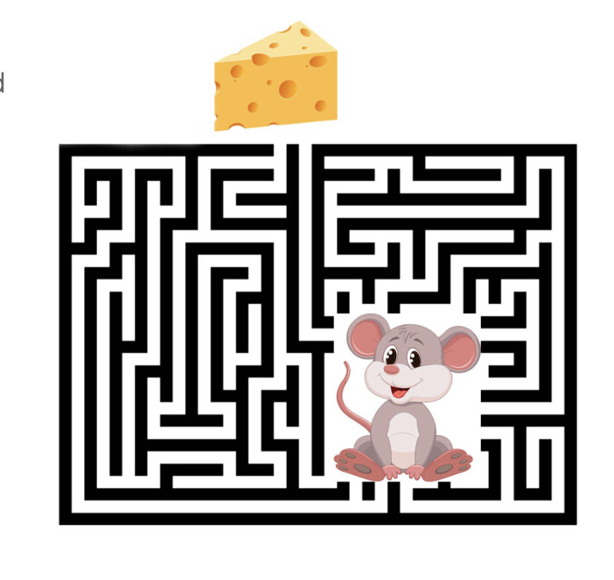
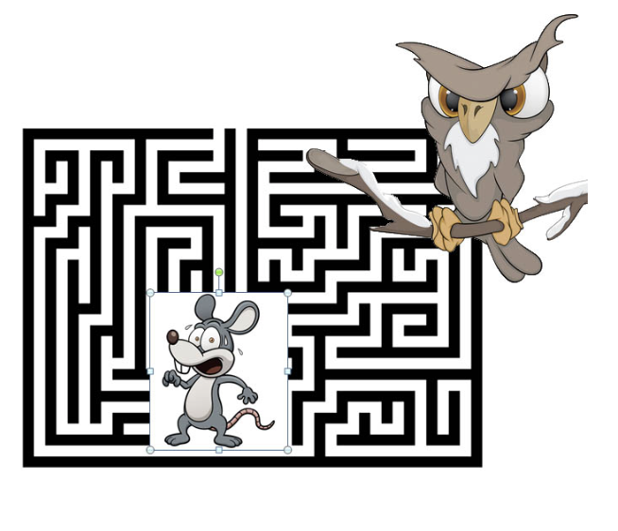
Fostering emotional wellness in your workplace
Incentivize with rewards, not with fear
University of Maryland study (participants who initially solved “cheese” maze were twice as creative (approach vs. avoidance mode)

Slide 25
How can I improve my self-care in these areas?
Physically?
Emotionally?
Spiritually?
Socially?

Slide 26
What is my system for implementing these strategies?
Physically?
Emotionally?
Spiritually?
Socially?

Slide 27
Self-care implementation
Takes an active decision
Change your shoulds into musts
Think about how you will feel when you implement your plan: (relieved, accomplished, inspired, passionate, playful, energized, motivated, excited)
Remember that complexity is the enemy of execution
Take massive action!
Associate self-care with pleasure instead of pain.
Remember why you are doing this!

Slide 28
Self-care plan
What area of your life do you want to change?
Why do you want to change?
What are barriers to changing?
What action are you going to take to make this change? How will you feel when you take this action?
How will you make it a must?
How will you associate this with pleasure?
How will you consistently remember your why?

Slide 29
In summary
Be creative, have fun, remember to play
Not everything you do has to be “productive”
Take a break if you feel self-helped out
Reflect on what works and what doesn’t
When your cup is full, let your peace and joy spill out to the others in your life. The goal of self-care is to grow so we can contribute to and serve others.

Slide 30
Questions or comments?
Jennifer.londgren@mnsu.edu

