Slide 1
Trauma Triage
Steve Lansing, PhD, LICSW
Ross Lustig, MA, LPCC
Renee Lips-Bush, LICSW, LADC
11th Annual Co-Occurring Disorders Symposium
January 25, 2023
5:30-7:30 pm

Slide 2
Disclaimer
Notes:
Steve will discuss this slide.

Slide 3
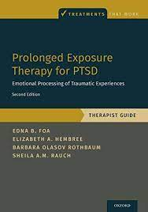
Prolonged Exposure Therapy (PE)
“Overall aim of PE is to help trauma survivors emotionally process their traumatic experiences to diminish or eliminate PTSD and other trauma related symptoms” (Foa et al., 2019, p. 2).
Foa, E. B., Hembree, E. A., Rothbaum, B. O., & Rauch, S.A.M. (2019). Prolonged exposure therapy for PTSD: Emotional processing of traumatic experiences: Therapist guide. Oxford University Press.

Slide 4
Structure of PE
Consists of 8-15 weekly sessions or twice weekly sessions
90-minute sessions
HOWEVER!!!
Since the first edition, a few other methods have been found to be effective.
Massed sessions provided every day for 2 weeks.
60-minute sessions

Slide 5
Key Components of PE
Education
Repeated In Vivo Confrontation
Repeated Prolonged Imaginal Exposure
Strong Therapeutic Alliance

Slide 6
Session Outline
Materials Needed
Session Outline
Overview
Homework Review
Set Agenda
Topic – may include psychoeducation
Assign Homework

Slide 7
Session 1
Overview
Trauma Interview – Therapist Completes
Breathing Retraining
Recording
Each session should be recorded for the client to review for homework.
In session 1, a separate recording for breathing retraining should be made.
Options: Client’s phone, digital recorder, PE Coach 2 App.

Slide 8
Session 2
SUDS
0 = Watching TV in bed, very relaxed.
25 = Taking a bus across town.
50 = Making a mistake and being asked to meet the boss and explain the mistake.
75 = Getting pulled over.
100 = How I felt during the worst moment of the trauma.

Slide 9
Session 3
Rationale for Imaginal Exposure
First Imaginal Exposure

Slide 10
Benefits | Risks
Reduction in PTSD symptoms and all other trauma related problems including depression, general anxiety, anger, SIB, and guilt. | Temporary Discomfort
 | Others May Listen to Recording
 | Processing Trauma Directly

Slide 11
Who Can Benefit from PE?
Works Well | Caution
Individuals w/ significant PTSD symptoms a month or more after trauma which are distressing and/or interfering w/ daily functioning. Multiple and severe comorbid problems with PTSD Memories can vary in length – can be partial memories Military Service Members and Veterans Anger Mild to Moderate TBI Dissociation* Personality Disorder PTSD with prominent guilt and/or shame+ | Imminent threat of suicdial or homicidal behavior. No memory of traumatic event Serious SIB. Current psychosis. Current high risk of being assaulted Dissociative symptoms that outweigh PTSD related symptoms.

Slide 12
Training and Going Further
Book: Prolonged Exposure Therapy for PTSD: Emotional Process of Traumatic Experiences 2nd Edition- Therapist Guide and Client Workbook
Book: Prolonged Exposure Therapy for Adolescents with PTSD: Emotional Processing of Traumatic Experiences 1st Edition – Therapist Guide and Client Workbook
VA: https://www.ptsd.va.gov/professional/treat/txessentials/prolonged_exposure_pro.asp
VA PTSD Treatment Decision Aid: https://www.ptsd.va.gov/apps/decisionaid/
Medical University of South Carolina National Crime Victims Research and Treatment Center: http://pe.musc.edu/introduction
DBT and PE: https://dbtpe.org/treatment-overview
Trainings are offered through several universities such as Harvard and University of Pennsylvania, as well as other organizations like PESI.

Slide 13
EMDR Therapy
Ross M. Lustig M.A. LPCC

Slide 14
Adaptive Information Process Model (AIP)
Intrinsic, physical, and adaptive
Integrates internal and external experiences
Associative memory networks- the basis of perception , attitude and behavior
Experiences translated into physically stored memories
Stored memory experiences contribute to pathology and health
Trauma causes disruption of normal adaptive information processing- unprocessed information dysfunctionally held in memory networks.

Slide 15
Memory systems
Implicit Memory
Contains the somatic, perceptual, & behavioral elements of memory
The memories that surprise us with their emotional charge when triggered
Relies on brain structures present from birth
Explicit Memory
The factual or autobiographical elements of memory
Memories of events with neutral emotional tone
Based on the development of the medial temporal lobe and the orbitofrontal cortex
Prior to 3 yrs the brain is not fully developed to process and create explicit memories.

Slide 16
The 8 Phases of EMDR Therapy
Phase 1
Trauma Inventory
Phase 2
Resourcing/ Evaluation
Phase 3
Lighting Up the Neuro-Network
Phase 4
Reprocessing
Phase 5
Body Scan
Phase 6
Uploading Positive Cognitions
Phase 7
Closing
Phase 8
Reassessment

Slide 17
Phases 1&2- Setting Targets and Resource Development
Identifying “touchstone” events, the earliest event which is the root of the identified trauma and naming the worst experience with that trauma.
Identifying targets that the client would like to reprocess and helping them choose the core implicit memories that are associated with each trauma.
Development of resources to teach them to regulate their emotions in the present and use guided and self-guided imagery to practice mindfulness and presence in the here and now.

Slide 18
Phase 3- Lighting up the Neuro-Network
Selecting a target memory to reprocess, then guiding them to focus on the implicit memories of the memory to prepare it for stage 4.
TICES
Thoughts
Images
Cognitions of self- “I am ______”
Emotions
Sensations

Slide 19
Phase 4- Reprocessing
Movement of the eyes as guided by the therapist’s hand or specialized lights.
The somatic stimulation of the hands using specialized “tappers” that alternately vibrate from one had to the other.
Teletherapy clients may use the “butterfly technique” or specialized apps to provide bilateral stimulation.

Slide 20
Phase 5- Somatic Symptoms
Client identifies any additional somatic information remaining in the body after phase four is complete
Somatic symptoms are then reprocessed with phase four bilateral stimulation and allowed to express themselves fully

Slide 21
Phase 6-7 Uploading Positive Cognitions and Closing/Reassessment
Processing like phase four, but slower and less intense so the client can maintain mindfulness about the positive cognitions.
Statements about the overall safety, value, or strengths of the individual are chosen to replace the negative cognitions in the brain.
Closing- Involves using mindfulness techniques to ground the client in the here and now and return them to a calm state.
Reassessment- Returning to previously reprocessed targets to evaluate the impact of them upon the individual and prepare them to address them again.

Slide 23
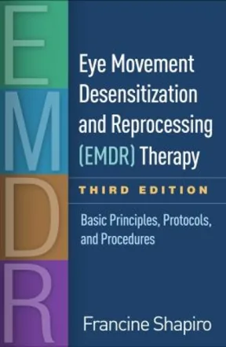
Resources
hector-matascastillo.mykajabi.com
EMDRIA.com

Slide 24
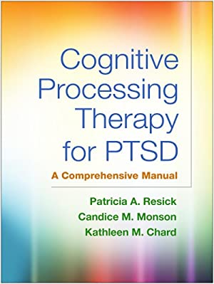
Cognitive Processing Therapy
Evidenced Based Treatment for PTSD
And
Related Trauma

Slide 25
Why I Choose CPT
IMPACT!!
Trauma
Event

Slide 26
Cognitive Processing Therapy (CPT)
Cognitive processing therapy (CPT) is a specific type of cognitive behavioral therapy that has been effective in reducing symptoms of PTSD that have developed after experiencing a variety of traumatic events including child abuse, combat, rape and natural disasters.

Slide 27
CPT is generally delivered over 12 sessions and helps patients learn how to challenge and modify unhelpful beliefs related to the trauma. In so doing, the patient creates a new understanding and conceptualization of the traumatic event so that it reduces its ongoing negative effects on current life.

Slide 28
Phases of CPT
Initial | Assess impact of the trauma Understand the condition called “PTSD” Teach connection between thoughts and feelings
Middle | Written account of the trauma Explore meaning of trauma Identify stuck points Introduce tools
Final | Examination of evidence for thoughts and beliefs Challenging beliefs using tools Reassess impact of trauma – revised impact statement

Slide 29
Stuck Points
Stuck Points are thoughts that you have that keep you stuck from recovering.
These thoughts may not be 100% accurate.
Stuck Points may be:
Thoughts about your understanding of why the traumatic event happened.
Thoughts about yourself, others, and the world that have changed dramatically as a result of the traumatic event.
Stuck Points are concise statements (but they must be longer than one word—for example, “trust” is not a Stuck Point).
Stuck Points can often be formatted in an “If–then” structure. Here is an example: “If I let others get close, then I will get hurt.”
Stuck Points often use extreme language, such as “never,” “always,” or “everyone.”
There are two types of Stuck Points:
Assimilated
Over Accommodation

Slide 30
Areas of Greatest Trauma Impact
Issues of Safety
1
Issues of Trust
2
Issues of Power and Control
3
Issues of Esteem
4
Issues of Intimacy
5

Slide 31
The Tools
ABC Worksheet
Challenging Questions
Patterns of Problematic Thinking
Challenging Beliefs Worksheet (CBW)
Specific Trauma Impact Worksheets
OOSA

Slide 32
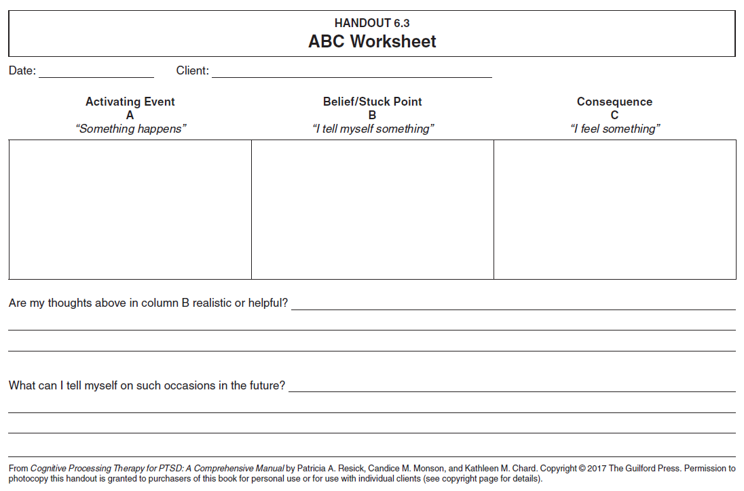

Slide 33
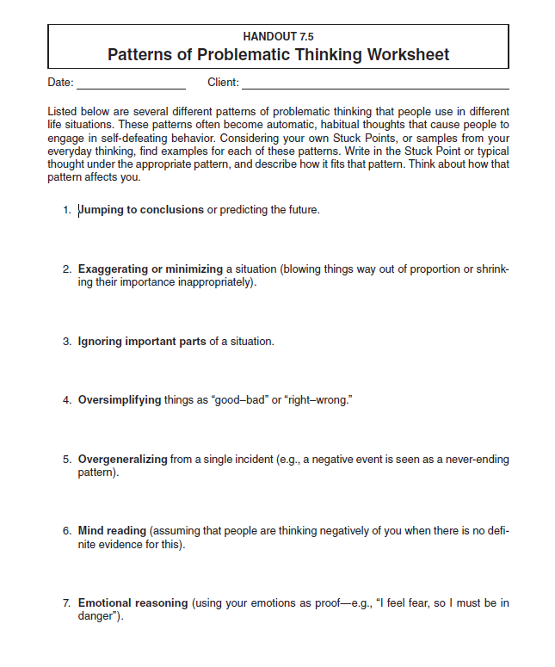
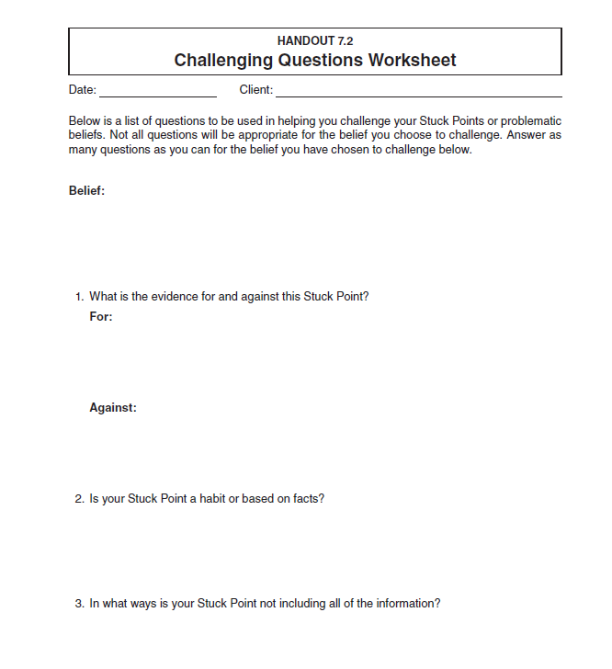

Slide 34
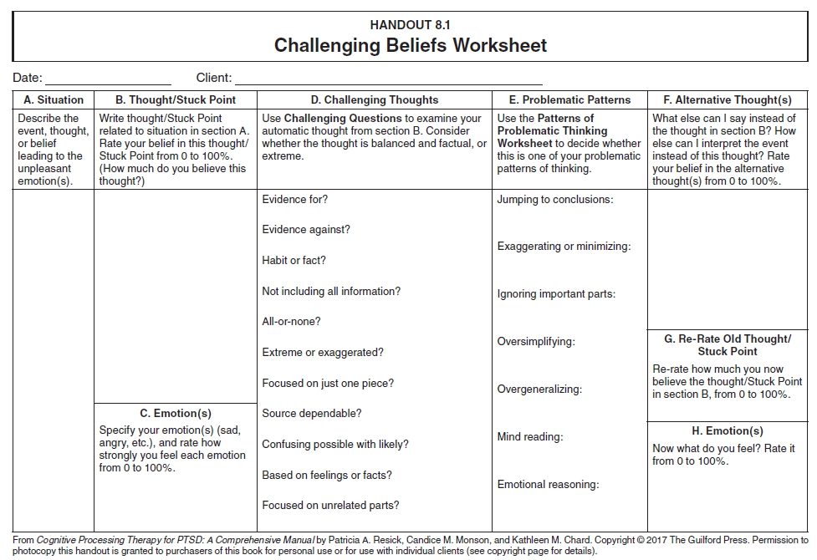

Slide 35
Training and Going Further
Book: Cognitive Processing Therapy for PTSD
Online Course: https://cpt.musc.edu/
Cognitive Processing Therapy: https://cptforptsd.com/
National Center for PTSD: https://www.ptsd.va.gov/understand_tx/cognitive_processing.asp
Formal Course: 16 hours+
cptforptsd site. www.cptforptsd.com will give training dates and options
PESI Course
Advanced and specialty courses
Consultation for full certification/approved provider
Other places

Slide 36
Question and Answer
Steve Lansing - steve@empowerctc.com
Ross Lustig – rossl@schrc.com
Renee Lips-Bush – reneelb@schrc.com
Check Out - VA PTSD Treatment Decision Aid https://www.ptsd.va.gov/apps/decisionaid/

