Slide 1
Hope and Healing
The Intersection of Domestic Violence, Sexual Assault, and Substance Use Disorders and How You Can Effect Change

Slide 2
Disclosure: We are receiving an honorarium for presenting today. Additionally, registration fees and a one-night stay in the hotel has been waived in support of our attendance. To our knowledge, we have no conflicts of interest with this presentation. The intention of this information is to further the education of the attendees and does not necessarily reflect the views of the sponsors of this conference.

Slide 3
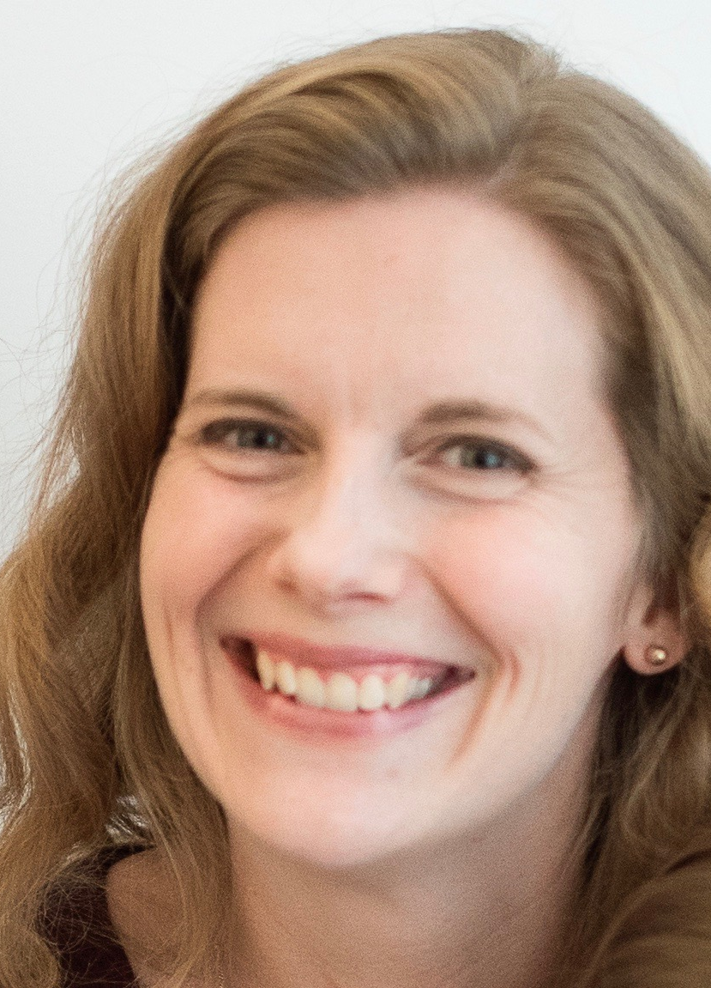
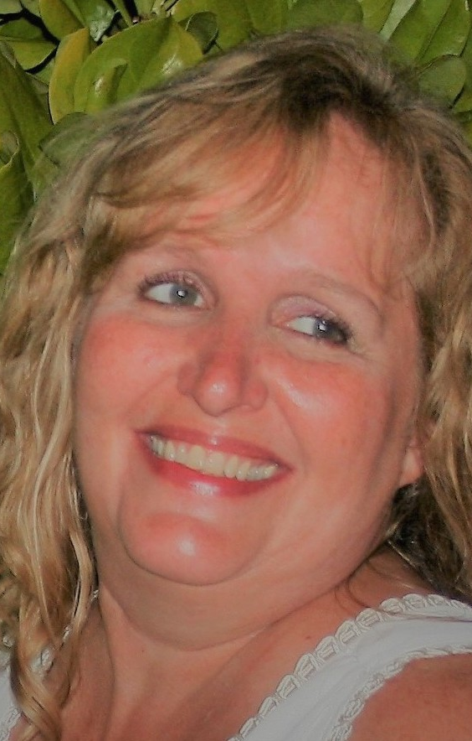
Integrated Service Strategies
Megan B. Jones (she/her) and Barb Rindels-Rasmusson (she/her)
Nice to meet you!
Notes:
Be sure to introduce self and work background!

Slide 4
Important notes before we begin

Slide 5
Land Acknowledgement
We are honored by all we have learned from our BIPOC clients and colleagues.
We will continue to honor our BIPOC clients, colleagues, neighbors, friends and family and recognize our place within history.
We will build mindfulness in our present participation in colonialism and work to end racism.
We live, work, love and learn on the lands of the Ioway, Meskwaki, Kickapoo and Ochethi Sakowin tribes. Today, we learn on the land of these same tribes.
Native-land.ca
Notes:
BIPOC= Black Indigenous Persons of Color

Slide 6
Gender and Sexuality
We recognize that all marginalized genders are at a higher risk for trauma, mental health issues and substance use disorders.
Sexual and intimate partner violence is not limited to straight relationships.
Sexual and intimate partner violence is a gender-based crime.
We honor all gender expressions and work towards reducing barriers to LGBTQ+ positive services.
EVERYONE IS WELCOME IN RECOVERY!

Slide 7
Trigger warning
We honor the varied experiences that bring us to this important work.
Some of information and stories shared today may affect you deeply.
Please practice self care.
RAINN:1-800-6564673
NDVH: 1-800-799-7233
SAMHSA: 1-800-662- HELP

Slide 8
Identifying the problem
Iowa Research:
2001: Initial research was done on the relationships between women’s experiences of partner violence and substance use disorders in 9 domestic violence/sexual assault programs & 7 substance use disorder treatment agencies across eastern Iowa.

Slide 9
Iowa Research Continued

Slide 10
National Statistics
A National Institute on Drug Abuse study noted 90% of women in drug treatment had experienced severe domestic and/or sexual violence from a partner.
Between 67-80% of women in substance use treatment are DV victims.
In domestic violence shelters and agencies, 65% of women either met criteria for alcohol dependence or reported problems with their drug use.
50-60% of men who abuse their partners have substance use problems
Men who perpetrate violence and use alcohol are twice a likely to inflect serious injury or death
70% of men who abuse their partners also abuse their children

Slide 11
INCREASED HARM IN MARGINALIZED COMMUNITIES
Mental illness: 50% of women who experienced IPV had a mental health problem, and 75% of women who experienced “severe” IPV had one or more mental health problems (Mason and O’Rinn, 2014)
BIPOC: 40% of BIPOC women and 50% of biracial women have experienced IPV in their lifetime, a rate of 30-40% higher than what is experienced by white women.
LGBTQ+:44% of lesbian women, 61% of bisexual women experience IPV, which is 35% higher than straight women. (National Intimate Partner and Sexual Violence Survey, 2020).
Coercive Control and Access to Services: these factors can often be used as a tool of control and abuse in relationships (insults, threats, barriers to service, etc).

Slide 12
COMPOUND Trauma/Intersectionality
LACK OF TRANSPORTATION
GAMBLING ADDICTION
SEXUAL ASSAULT
RACISM
INTIMATE PARTNER VIOLENCE
LACK OF CHILDCARE
MENTAL ILLNESS
TRANSPHOBIA
LACK OF EDUCATION
POVERTY
INTERGENERATIONAL TRAUMA
SUBSTANCE USE DISORDERS
HOMOPHOBIA
COLONIALISM
DISCRIMINATION
MALNUTRITION
IMMIGRATION STATUS
SEX TRAFFICKING
ACCESS TO HEALTHCARE
UNEMPLOYMENT
LACK OF HOUSING
DEATH/LOSS
SEXUAL HARASSMENT
DIFFERING ABILITIES/NEURODIVERSE
ILLNESS
DISCONNECT FROM CULTURE
LANGUAGE BARRIERS
Integrated Service Strategies
Notes:
STOP HERE AND DO PATTI’S SKIT

Slide 13
VOICES OF SURVIVORS WILL GUIDE THE WORK
“Yeah, that (emotional abuse) was the big reason why I had a drug problem in the first place…”
“I had no idea that it wasn’t my fault until an advocate came to my group. He always told me he beat me because I’m a drunk.”

Slide 14
VOICES OF SURVIVORS WILL GUIDE THE WORK
“One thing that I think would probably be beneficial is places like the (agency) here to have some sort of a substance abuse person there to offer services, I mean I know that they let you know, “Okay, here’s some of the resources in town,” but when you’re in domestic violence relationship and you’re just getting out of it, sometimes, I don’t know what it is, you just don’t have all your strength and everything inside of you to just go out and get whatever help you may need, and in my particular situation, my drug addiction was directly related to domestic violence.”(ISP AREA GRANT RESEARCH, 2007)

Slide 15
Red flags that your client may have experienced intimate partner violence and/or sexual assault
Signs of depression
Increased substance use
Sexually transmitted infections
Avoiding situations/locations that didn’t cause anxiety before
Withdrawing from family, friends, coworkers; reports partner is limiting contact with others
Signs that partner is monitoring/limiting communication with others
Reports that partner seemed perfect at first and the relationship moved quickly.
Reports that partner is excessively jealous
Reports partner has a history of abusive relationships and/or blames the end of past relationships entirely on their ex.
Reports partner rages out of control around them, but maintains composure around others.
Notes:
BE SURE TO MENTION: SUD/PC wheel in handouts; go to: https://ncdvtmh.org/wp-content/uploads/2023/02/PowerandControlModelforWomensSubstanceAbuse.pdf to show example

Slide 16
Importance of Integrating Work
Linking safety with recovery
Increase in lethality
Trauma increases the risk of developing a substance use disorder.
Substance misuse makes it harder to escape a violent situation or heal from past abuse. Continuing unresolved feelings about abuse is a relapse trigger.
Substance use/misuse impairs judgment which makes safety planning more difficult.
It is much easier to control a person who has a substance use disorder; it’s common for people who do harm to sabotage recovery. (Patti Bland)
If a perpetrator is intoxicated, there is a greater risk the victim /survivor will be injured or killed. If the victim/survivor is intoxicated, they may find it harder to get safe. (Patti Bland, 1997)
Being in treatment can increase a person’s risk to be stalked/tracked by a person doing harm.
During the first violent partner relationship, 68% of the abusive partners were using alcohol or drugs or both at the time of a violent incident, 31% of the victims were using at the time. In current partner relationships, 67% of the abusive partners were using at the time of a violent incident, 43% of the victims were using at the time. (Downs, 2001)
Integrated Service Strategies

Slide 17
IT’S NOT ENOUGH
Referrals
Open door policies
“They can talk about it if they want to.”
Single question during assessment, then no follow up. “Have you ever been a victim or perpetrator of domestic violence?”
“Just leave them.”

Slide 18
Integrating Services: The Iowa Model
Collaborate
Educate
Integrate

Slide 19
Iowa Model
Collaborative learning environment
Increase staff knowledge and create a minimum level of competency
Educational programming reaching at least 75% of staff from each agency
Integrating care for those experiencing trauma and substance use issues.

Slide 20
Examples of Service Integration in Iowa
Co-led groups
Increased gender specific services focused on trauma and recovery
Providing SUD and IPV education in already established groups
Increased awareness and referrals
Regular consultations and in-services on IPV and SUD issues
Co-led public education
Drug court/family court involvement
Joint community coalitions
Policy development re: screening, expediting admission to treatment
Co-located services
Notes:
Co-led groups: a group specifically for women experiencing DV, SV and SUD, regular attendance/presentation in already established groups, advocate led groups in residential, advocate led groups for adolescents receiving treatment, counselors coming to support groups to do education/group work.
Add national examples such as: increased screening tools, having a licensed mh/sud counselor on staff at shelter, 100% service integration at Lafayette House.

Slide 21
National Examples of Service Integration
Lafayette House in Joplin, Missouri
Alaska Network on Domestic Violence and Sexual Assault (ANDVSA) and Alaska Native Tribal Health Consortium
Washington State Coalition Against Domestic Violence (WSCADV) Housing First Initiative
Ohio Domestic Violence Network: SUD specialist on staff, integrating with TBI services
Nebraska and Maryland professionals on staff

Slide 22
Strategies to Educate
Ask
Ask for education on basic domestic violence/sexual assault issues and services for your staff. Invite advocates to present at an all-staff meeting.
Offer
Offer training to their staff on substance use disorders and services you provide.
Collaborate
Collaborate on bringing a presenter to your community or doing prevention work together in your community
Attend
Attend trainings that the other agency typically attends and network!
Educate
Educate yourself: books, media, articles- or better yet, start a professional book club!

Slide 23
Strategies to Collaborate
Hold regular or as needed case consultations with each other
Have an advocate regularly attend team meetings/all staff meetings
Have key players attend quarterly lunches
Invite your local advocates to treatment/family court (if they aren’t there already)
Make sure you have QSA/MOUs in place to cover confidentiality needs.

Slide 24
Strategies to Integrate
Call your local advocacy agency and ask them to do an educational presentation in your group(s). If it goes well, ask them to come on a rotational basis and find out if they can present in other groups. If the group is co-ed, encourage the advocate to present on healthy relationships, witnessing IPV in the home, and surviving childhood abuse.
If a victim/survivor discloses abuse, offer to have an advocate come speak to them during one of your sessions or speak with an advocate over the phone while in session. This can be much safer for the victim/survivor as the perpetrator may never know that they are receiving DV/SA services while in treatment.
Offer to keep copies of No Contact Orders and other important documents in client files; this can be very helpful if the victim/survivor decides to leave.
Have Safety Plans readily available to discuss and complete during sessions (and be sure you are trained on how to complete!)
Once a relationship is established, start a co-led group!

Slide 25
Assessment Examples
CAGE-DV
Have you ever felt controlled or threatened by your partner?
Has anyone annoyed you or gotten on your nerves by expressing concern about your partner’s behavior towards you?
Have you ever felt guilty or bad about how your partner treats you?
How often do you wake up anxious, afraid or wanting to escape your partner?
Are you afraid of your partner? When did this start? What was the most dangerous thing that happened?
Does your partner try to discourage you from your support system?
Tell me about a typical disagreement between you and your partner.
We find that about 90-95% of women who receive services from us also have difficulties in their relationships, including emotional, physical and sexual abuse. Has anything like that ever happened to you?
Many women tell me their partners don’t want to use alone. How often do you find yourself using when you don’t really want to?

Slide 26
Integrated Group Examples
Curriculums to consider
Real Tools (website)
Blue Sky (website)
Seeking Safety
Winging it
Other considerations
Confidentiality rules for group members
Creative name of group
Intake for group
In substance use group can advocates bring in their clients?
Is it an open group or a closed group?
What agency agreements need to be in place? QSO/MOU
What group curricula will be used?
Can SUD treatment bill for this service?
Notes:
STOP HERE AND WATCH CONSENT TEA: https://www.youtube.com/watch?v=fGoWLWS4-kU

Slide 27
Challenges to integrating services
It’s a long process for trainings and implementing integrated services.
Differing philosophical backgrounds and service provision.
Continued education for new staff
Funding sources
Notes:
Challenges: it is a long process for trainings and implementing integrated services; differing philosophical backgrounds and service provision for women; continued education for new staff members, funding sources (ISP grant funds and agency funding low/depleted), etc.

Slide 28
What are your ideas for your community?
Let’s brainstorm!
Notes:
Ask audience to take a moment, get out a piece of paper, write down three ideas either from ideas discussed in presentation or ideas of their own, that they feel is a realistic option for them to do in their community. Ask them to take one idea and write down 2-3 action steps to make this idea a reality when they get back to their office. Maybe even put “deadlines” next to the action steps. If time, ask them to share in small groups or the large group what they wrote down.

Slide 29
“hope is not always soft and lovely. she is not always cascading rivers and sunlit skies, dancing. hope knows there is work to be done.”
– from bare bones
by ullie-kaye

Slide 30
Thank you!
Megan Jones
Megan.integratedservice@gmail.com
Barb Rasmusson
Barb.integratedservice@gmail.com
www.integratedservicestrategies.com

