Slide 1
The Legalization of Marijuana: An Ethical and Clinical Conversation of the Issue
Facilitated by:
Thad Shunkwiler, LMFT, LPCC, CCMHC, ACS, NCC
&
Eric Thompson, J.D.
Drug Court Coordinator
Dodge County Drug Court

Slide 2
Introductions

Slide 3
Legal Disclaimer
The information in this presentation is for educational purposes only and is the sole opinion of the presenter.
The presentation is not intended to provide specific legal advice, nor supersede any internal policies for your respective occupational setting.
It is always best practice to obtain legal advice from an attorney with expertise in the subject matter and jurisdiction.
Notes:
THAD- I won’t answer any questions that start with “What would the board do if….”

Slide 4
Agenda
Minnesota Cannabis Law: What we know
Conversation on the potential implications of legalization
Talking with your clients about cannabis
Learning Outcome:
Understand the ethical and treatment implications of legalization and develop skills to educate clients and stakeholders on the issues.

Slide 5
Minnesota Law and Cannabis Legalization
Effective Aug. 1, 2023, full decriminalization will allow the possession, use, and home grow of cannabis in Minnesota for people 21 and older. As outlined in law, a person age 21 or older may:
Use, possess, or transport cannabis paraphernalia.
Possess or transport up to 2 ounces of cannabis flower in a public place.
Possess up to 2 pounds of cannabis flower in a person’s private residence.
Possess or transport up to 8 grams of adult-use concentrate.
Possess or transport edible cannabis products or lower-potency hemp edibles infused with a combined 800 milligrams or less of THC.
Give away cannabis flower and products to a person 21 or older in an amount legal for a person to possess in public.

Slide 6
Minnesota Law and Cannabis Legalization
Where can cannabis be used?
Cannabis can be used by people 21 and older on private property (unless the owner prohibits use of cannabis on their property), private residences and at places with approved licenses or an event permit (however, no licenses or event permits are available at this time).
Cannabis cannot be used or possessed in the following locations:
Public school or charter schools and school buses
State correctional facilities
In a location where the smoke, aerosol or vapor of a cannabis product could be inhaled by a minor
On federal property (such as courthouses, airports and national parks)
In federally subsidized housing. Due to the federal prohibition of cannabis, the U.S. Department of Housing and Urban Development (HUD) does not have the discretion to admit or retain users of cannabis (i.e., marijuana), including medical cannabis, to the public housing program.
While on an employer's premises, or operating an employer's vehicle, machinery or equipment
Smoking or vaping adult-use cannabis products is prohibited in a multifamily housing building, including patios and balconies (effective March 1, 2025). Owners of day cares must disclose to parents if the proprietors permit use of cannabis outside of its normal business hours. NOTE: Communities may have local ordinances that prohibit smoking or vaping cannabis in public places.

Slide 7
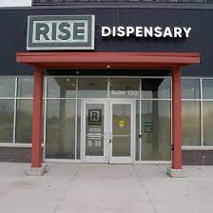
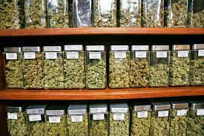
Minnesota Law and Cannabis Legalization
What we don’t yet know

Slide 8
What is your definition of ethics?

Slide 9
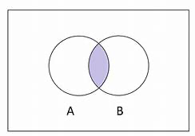
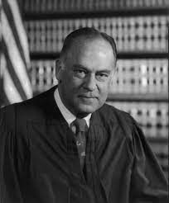
What are ethics?
The intersection of:
morality and science
“Ethics is knowing the difference between what you have a right to do and what is right to do.” – Potter Stewart- US Supreme Court Justice
*Cynthia Geppert, MD

Slide 10
Small Group Breakout #1
What are your thoughts on the legalization of cannabis in Minnesota?
What are the potential ethical implications facing our professions?

Slide 11
Large Group Process #1

Slide 12
Small Group Breakout #2
What are the potential treatment implications facing our professions?
If you had a voice in the creation of the law and the rules regarding retail sales, what would you say?

Slide 13
Large Group Process #2

Slide 14
Small Group Breakout #3
How will you engage clients in conversations regarding use of cannabis?
What strategies have been effective or ineffective?

Slide 15
Large Group Process #3

Slide 16
Case Study: Talking with your clients
Julie is a 28-year-old mother of 3 with a lengthy history of methamphetamine abuse. Julie was referred to your drug court for charges related to sales and possession and has been working through the program and will soon be ready to graduate. She comes to talk with you about her future when she is “off paper.”
She wants to know your thoughts on her starting to use cannabis to relax and cope with the stresses of life. She maintains that it’s better than alcohol and now that it’s legal, doesn’t really see any issues.

Slide 17
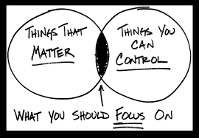
Moving Forward

Slide 18
Questions

