Slide 1
Stop Pathologizing Me: Normal vs Abnormal Psychological Responses to Life’s Challenges
Thad Shunkwiler, LMFT, LPCC, CCMHC, ACS, NCC
Associate Professor
Department of Health Science
Minnesota State University, Mankato
Fellow- National Rural Health Association

Slide 2
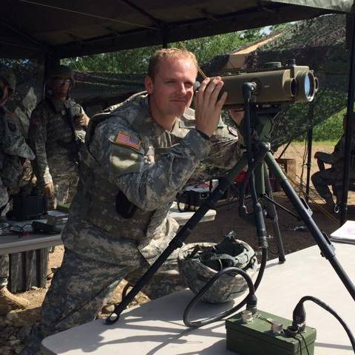
Introductions
Who am I?
Who are you?
Why this topic?

Slide 3
Disclaimer
The information in this presentation is for educational purposes only and is the sole opinion of the presenter.
Mental illness is real, but our profession needs to seriously examine our role in access to care.
Notes:
THAD

Slide 4
Training Outline
Definitions and theoretical orientation to mental illness
History of stigma
Campaigns to legitimize mental health
Diagnostic differentiation
Alternative intervention
Skill development
Learning Outcome: How do I use this information with my clients.
I Want YOU
To Participate!
Notes:
THAD

Slide 5
Definitions

Slide 6
Definitions
What is your definition of mental illness?

Slide 7
Normal vs Abnormal Behavioral Health
When does someone go from normal to abnormal behavior?

Slide 8
Philosophical Approach to Mental Illness
When does someone go from well to sick?
When should we pathologize behavior?
What is the meaning and purpose of diagnosis?

Slide 9
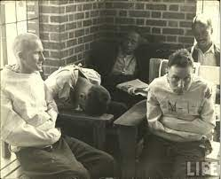
History of Mental Health Stigma
1800’s- Possessed by “evil spirits”
1900’s- Insane “wild beasts”
1920’s- World War 1 – “shell shock”

Slide 10
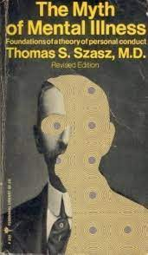
History of Mental Health Stigma
1950’s- DSM I
1960’s- Mental health as a moral illness
1980’s- DSM III as turning point

Slide 11
History of Mental Health Stigma

Slide 12
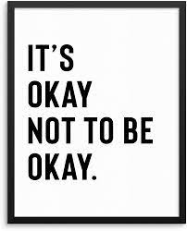
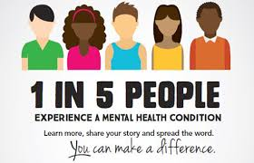
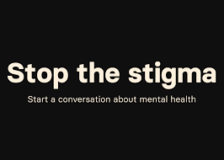
Campaigns to End the Stigma

Slide 13
Unintended Consequences?

Slide 14
“Psychology is more or less where the rest of medicine was a hundred years ago – at the very beginning of a long quest for valid diagnostic procedures.”
“There is a bias towards false positives so as not to miss anything.”
“The DSM-5 is not the problem, but the way we over-value it is. When does sadness turn into depression, particularly when life stressors (grief, job loss, breakups of intimate relations) that would upset almost anyone are present? When should anxiety and worry justify diagnosis if there is something real to worry about? At what point is substance use an addiction?”
“Overdiagnosis runs the danger of encouraging victimhood and discouraging a sense of responsibility for one's life. The debate about diagnosis is not just a matter of evaluating empirical data, but about society's concern over oppression and suffering. That cannot be good for psychiatry, which must put science ahead of politics.”

Slide 15
Unintended Consequences?

Slide 16
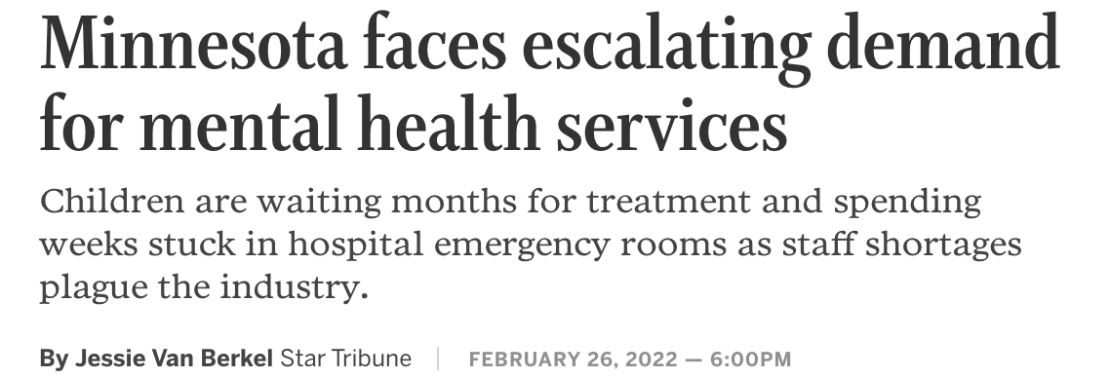
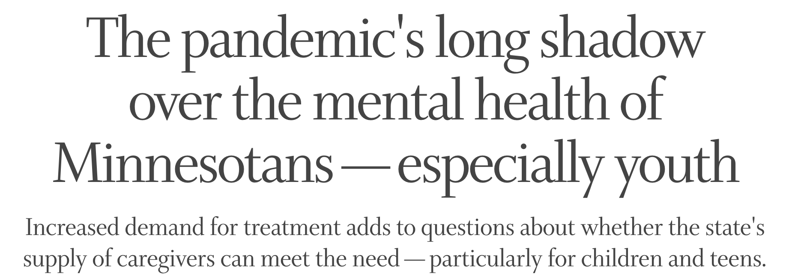
Unintended Consequences?

Slide 17
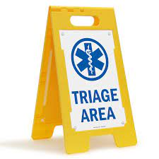
Right Diagnosis Right Resource Right Time
What has been your role in the above statement?
What has been your experience with navigating the challenges related to helping clients finding the right resource?

Slide 18
Differential Diagnosis
What are common differential diagnosis in behavioral health?

Slide 19
“Normal Human Unhappiness”

Slide 20
Differential Diagnosis: Consequences of getting it wrong
Notes:
Jail example- Meds don’t work if you don’t need them.

Slide 21
The Elephant in the Room
Notes:
My Dr. experience.

Slide 22
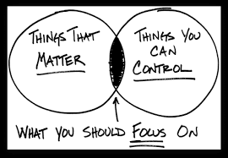

Slide 23
Normalizing Psychological Distress

Slide 24
Responsibility of Emotional Wellness

Slide 25
Support vs. Treatment Managing Psychological Distress
Support
Treatment
Continuum of care

Slide 26
Skill Development:
What does it look like to encourage clients to work through their abdicating responsibility for behavior due to “mental illness?”
What skills does one need to feel confident having these challenging conversations?
Let’s roll play!

Slide 27
Questions?
Thad.Shunkwiler@mnsu.edu

Slide 28
Sources
Merten, E.C., Cwik, J.C., Margraf, J. et al. Overdiagnosis of mental disorders in children and adolescents (in developed countries). Child Adolesc Psychiatry Ment Health 11, 5 (2017).
Bruchmüller K, Margraf J, Schneider S. Is ADHD diagnosed in accord with diagnostic criteria? Overdiagnosis and influence of client gender on diagnosis. J Consult Clin Psychol. 2012;80(1):128–38.
Chilakamarri JK, Filkowski MM, Ghaemi SN. Misdiagnosis of bipolar disorder in children and adolescents: a comparison with ADHD and major depressive disorder. Ann Clin Psychiatry. 2011;23(1):25–9.
Sciutto MJ, Eisenberg M. Evaluating the evidence for and against the overdiagnosis of ADHD. J Atten Disord. 2007;11:106–13.
Costello EJ, Erkanli A, Angold A. Is there an epidemic of child or adolescent depression? J Child Psychol Psychiatry. 2006;47(12):1263–71.
van Nieuwenhuizen, A., Henderson, C., Kassam, A., Graham, T., Murray, J., Howard, L. M., & Thornicroft, G. (2013). Emergency department staff views and experiences on diagnostic overshadowing related to people with mental illness. Epidemiology and psychiatric sciences, 22(3), 255–262. https://doi.org/10.1017/S2045796012000571
Lauber C, Anthony M, jdacic-Gross V, Rossler W (2004). What about psychiatrists' attitude to mentally ill people? European Psychiatry 19, 423–427.

